Slide 1

Data structure and Algorithm
Nguyễn Khánh Phương
Computer Science department
School of Information and Communication technology
E-mail: phuongnk@soict.hust.edu.vn

Slide 2
Course outline
Chapter 1. Fundamentals
Chapter 2. Basic data structures
Chapter 3. Tree
Chapter 4. Sorting
Chapter 5. Searching

Slide 3
Chapter 4. Sorting
Nguyễn Khánh Phương
Computer Science department
School of Information and Communication technology
E-mail: phuongnk@soict.hust.edu.vn

Slide 4
Sorting problem
Sorting is a process that organizes a collection of data into either ascending or descending order.
Different types of sorting algorithms:
Internal sort requires that the collection of data fit entirely in the computer’s main memory.
We can use an external sort when the collection of data cannot fit in the computer’s main memory all at once but must reside in secondary storage such as on a disk.
Parallel sort : uses multiple processors to sort, thus reduces the computation time

Slide 5
Properties of Sorting problem
In place
Sorting of a data structure does not require any external data structure for storing the intermediate steps
Stable
if two objects with equal keys appear in the same order in sorted output as they appear in the input array to be sorted.”
Before sorting
10
20
20
30
10
This sorting algorithm is stable because the order of the balls with equal key is not changed after sorting:
Blue ball of value 10 stands before the orange ball of value 10.
Same as blue and orange balls of value 20
This sorting algorithm is stable or not ?
After sorting
10
10
20
20
30

Slide 6
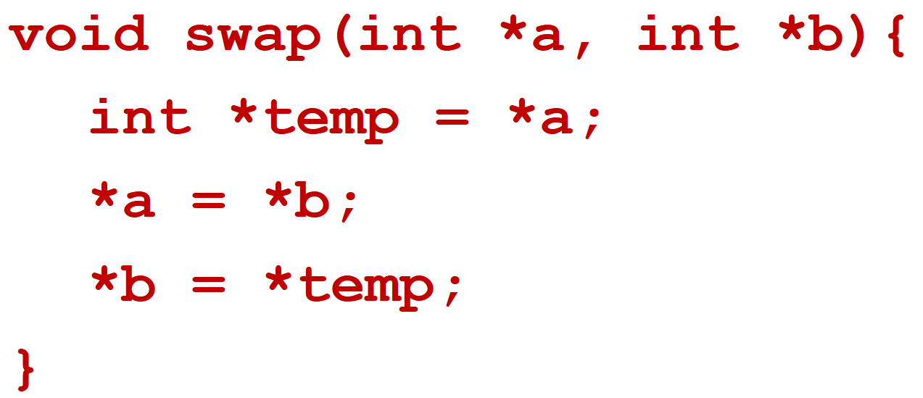
Sorting problem
There are 2 basic operations that sorting algorithms often use:
Exchange positions of 2 elements (Swap): running time O(1)
void swap( datatype *a, datatype *b){
datatype *temp = *a; //datatype- data type of element
*a = *b;
*b = *temp;
}
Compare: Compare(a, b) returns true if a is put before b in the sorted order, false otherwise
Sorting analysis: In general, we compare keys and move items (or exchange items) in a sorting algorithm (which uses key comparisons).
➔ So, to analyze a sorting algorithm we should count the number of data comparisons and the number of moves.
(Ignoring other operations does not affect our final result).
6
Notes:
Ta có thể làm tốt hơn sắp xếp chỉ sử dụng phép so sánh?
Với những thông tin bổ sung (hay là giả thiết) về đầu vào, chúng ta có thể làm tốt hơn sắp xếp chỉ dựa vào phép so sánh.
Thông tin bổ sung/Giả thiết:
Các số nguyên nằm trong khoảng [0..k] trong đó k = O(n).
Các số thực phân bố đều trong khoảng [0,1)
Ta trình bày ba thuật toán có thời gian tuyến tính:
Sắp xếp đếm (Counting-Sort)
Sắp xếp theo cơ số (Radix-Sort)
Sắp xếp đóng gói (Bucket-sort)
Để đơn giản cho việc trình bày, ta xét việc sắp xếp các số nguyên không âm.

Slide 7
Contents
4.1. Insertion Sort
4.2. Selection Sort
4.3. Bubble Sort
4.4. Merge Sort
4.5. Quick Sort
4.6. Heap Sort

Slide 8
Sorting: The Big Picture
Horrible algorithms:
Ω(n²)
Simple
algorithms:
O(n²)
Fancier
algorithms:
O(n log n)
Bogo Sort
Stooge Sort
Comparison
lower bound:
Ω(n log n)
Insertion sort
Selection sort
Bubble Sort
Shell sort
…
Specialized
algorithms:
O(n)
Heap sort
Merge sort
Quick sort (avg)
…
Bucket sort
Radix sort

Slide 9
Contents
4.1. Insertion Sort
4.2. Selection Sort
4.3. Bubble Sort
4.4. Merge Sort
4.5. Quick Sort
4.6. Heap Sort

Slide 10
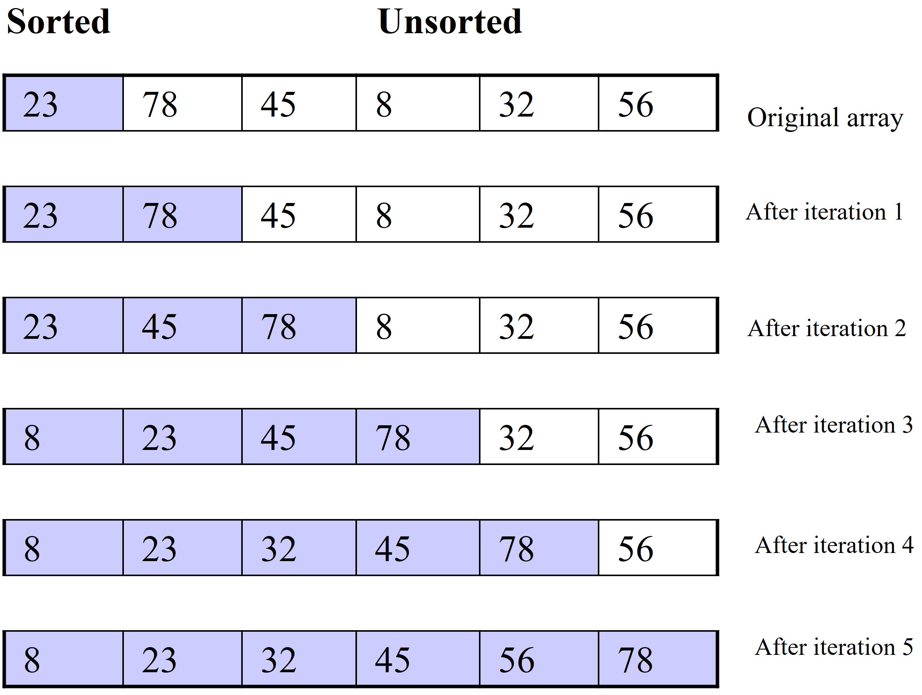
4.1. Insertion sort
Algorithm:
The array is divided into two subarrays, sorted and unsorted
Each iteration: the first element of the unsorted subarray is picked up, transferred to the sorted subarray, and inserted at the appropriate place.
➔ An array of n elements requires n-1 iterations to completely sort the array.

Slide 11
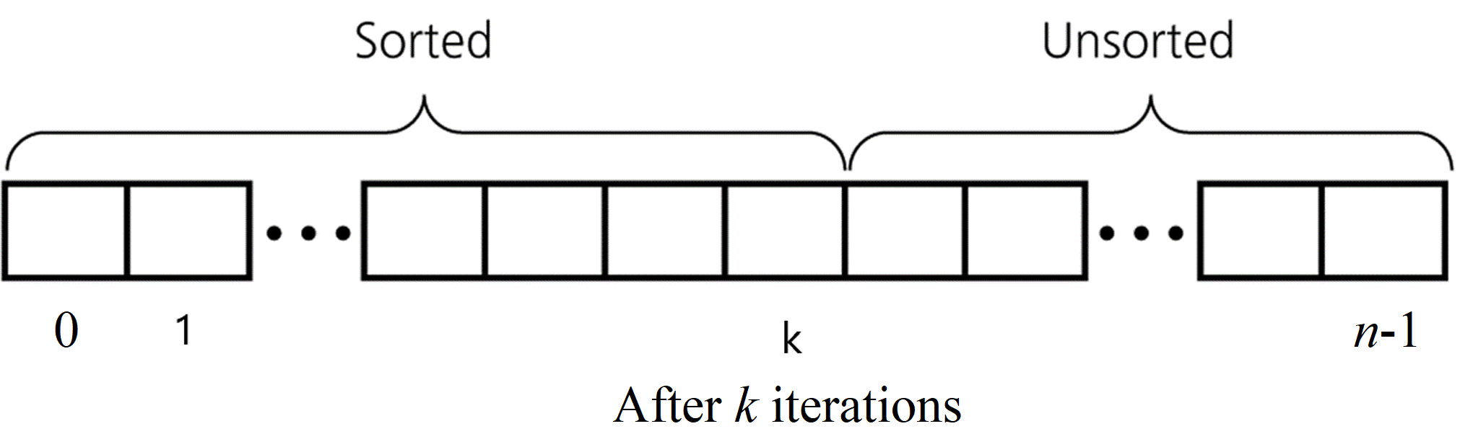
4.1. Insertion sort
Algorithm:
The array is divided into two subarrays, sorted and unsorted.
Each iteration: the first element of the unsorted subarray is picked up, transferred to the sorted subarray, and inserted at the appropriate place.
➔An array of n elements requires n-1 iterations to completely sort the array.
Iteration k = 1, 2, ..., n-1:
move the element A[k] to place such that after moving: the first (k+1) elements of array A is ordered
At each iteration k, it might need more than one time to swap elements to put element A[k] to place such that the first k elements of array A is ordered.
Iteration k: Repeatedly swap element k^{th} with the one to its left if smaller.

Slide 12
4.1. Insertion sort
Iteration k = 1, 2, ..., n-1:
move the element A[k] to place such that after moving: the first (k+1) elements of array A is ordered
At each iteration k, it might need more than one time to swap elements to put element A[k] to place such that the first k elements of array A is ordered.
Iteration k: Repeatedly swap element k^{th} with the one to its left if smaller.
Properties: Ater k^{th} iteration , A[0] through A[k] contain first k+1 elements in ascending order

Slide 13
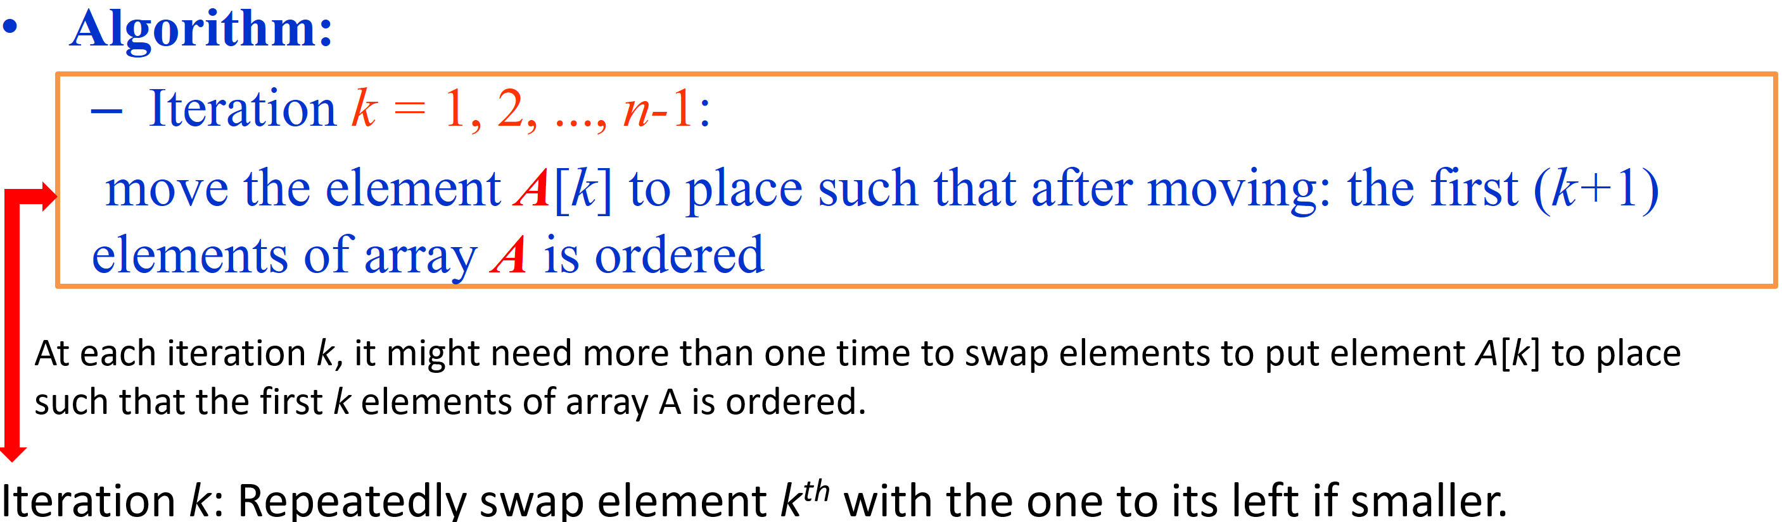
Implementation: Insertion Sort Algorithm
k=5: find place for a[5]=14
void insertionSort(int a[], int size);
a[0] | a[1] | a[2] | a[3] | a[4] | a[5] | a[6] | a[7]
13 | 17 | 20 | 28 | 42 | 14 | 23 | 15
temp = 14
13 | 17 | 20 | 28 | 42 | 42 | 23 | 15
13 | 17 | 20 | 28 | 28 | 42 | 23 | 15
13 | 17 | 20 | 20 | 28 | 42 | 23 | 15
13 | 17 | 17 | 20 | 28 | 42 | 23 | 15
for (int k = 1; k < size; k++) {
int temp = a[k];
int pos = k;
/* Iteration k: repeatedly swap element kth with the one to its left
if smaller*/
while (pos > 0 && a[pos-1] > temp) {
a[pos] = a[pos–1];
pos--;
} // end while
}

Slide 14
Implementation: Insertion Sort Algorithm
k=5: find place to put a[5]=14 so that elements from a[0] to a[5] are sorted
void insertionSort(int a[], int size);
a[0] | a[1] | a[2] | a[3] | a[4] | a[5] | a[6] | a[7]
13 | 17 | 20 | 28 | 42 | 14 | 23 | 15
temp = 14
13 | 17 | 20 | 28 | 42 | 42 | 23 | 15
13 | 17 | 20 | 28 | 28 | 42 | 23 | 15
13 | 17 | 20 | 20 | 28 | 42 | 23 | 15
13 | 17 | 17 | 20 | 28 | 42 | 23 | 15
13 | 14 | 17 | 20 | 28 | 42 | 23 | 15
After iteration k = 5:
a[0]…a[5] are sorted
unsorted
for (int k = 1; k < size; k++) {
int temp = a[k];
int pos = k;
/* Iteration k: repeatedly swap element kth with the one to its left
if smaller*/
while (pos > 0 && a[pos-1] > temp) {
a[pos] = a[pos–1];
pos--;
} // end while
// Insert the value temp (=a[k]) into correct place
a[pos] = temp;
}

Slide 15
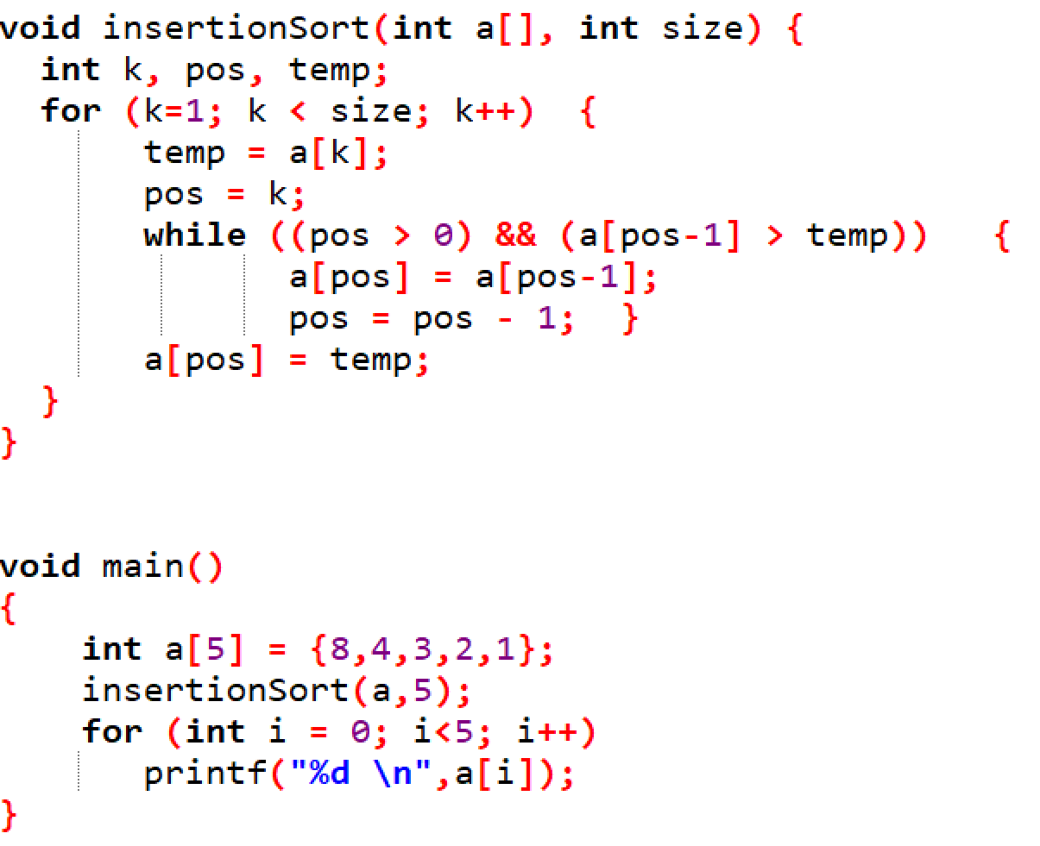
Implementation: Insertion Sort Algorithm

Slide 16
Example 1: Insertion Sort
Iteration k: repeatedly swap element k^{th} with the one to its left if smaller
Properties. After k^{th} iteration, A[0] through A[k] contain first k+1 elements in ascending order
Array index
0
1
2
3
4
5
6
7
8
9
Value
2.78
7.42
0.56
1.12
1.17
0.32
6.21
4.42
3.14
7.71
Iteration 0: step 0.

Slide 17
Example 1: Insertion Sort
Iteration k: repeatedly swap element k^{th} with the one to its left if smaller
Properties. After k^{th} iteration, A[0] through A[k] contain first k+1 elements in ascending order
Array index
0
1
2
3
4
5
6
7
8
9
Value
2.78
7.42
0.56
1.12
1.17
0.32
6.21
4.42
3.14
7.71
Iteration 1: step 0.

Slide 18
Example 1: Insertion Sort
Iteration k: repeatedly swap element k^{th} with the one to its left if smaller
Properties. After k^{th} iteration, A[0] through A[k] contain first k+1 elements in ascending order
Array index
0
1
2
3
4
5
6
7
8
9
Value
2.78
7.42
0.56
0.56
7.42
1.12
1.17
0.32
6.21
4.42
3.14
7.71
Iteration 2: step 0.

Slide 19
Example 1: Insertion Sort
Iteration k: repeatedly swap element k^{th} with the one to its left if smaller
Properties. After k^{th} iteration, A[0] through A[k] contain first k+1 elements in ascending order
Array index
0
1
2
3
4
5
6
7
8
9
Value
2.78
0.56
0.56
2.78
7.42
1.12
1.17
0.32
6.21
4.42
3.14
7.71
Iteration 2: step 1.

Slide 20
Example 1: Insertion Sort
Iteration k: repeatedly swap element k^{th} with the one to its left if smaller
Properties. After k^{th} iteration, A[0] through A[k] contain first k+1 elements in ascending order
Array index
0
1
2
3
4
5
6
7
8
9
Value
0.56
2.78
7.42
1.12
1.17
0.32
6.21
4.42
3.14
7.71
Iteration 2: step 2.

Slide 21
Example 1: Insertion Sort
Iteration k: repeatedly swap element k^{th} with the one to its left if smaller
Properties. After k^{th} iteration, A[0] through A[k] contain first k+1 elements in ascending order
Array index
0
1
2
3
4
5
6
7
8
9
Value
0.56
2.78
7.42
1.12
1.12
7.42
1.17
0.32
6.21
4.42
3.14
7.71
Iteration 3: step 0.

Slide 22
Example 1: Insertion Sort
Iteration k: repeatedly swap element k^{th} with the one to its left if smaller
Properties. After k^{th} iteration, A[0] through A[k] contain first k+1 elements in ascending order
Array index
0
1
2
3
4
5
6
7
8
9
Value
0.56
2.78
1.12
1.12
2.78
7.42
1.17
0.32
6.21
4.42
3.14
7.71
Iteration 3: step 1.

Slide 23
Example 1: Insertion Sort
Iteration k: repeatedly swap element k^{th} with the one to its left if smaller
Properties. After k^{th} iteration, A[0] through A[k] contain first k+1 elements in ascending order
Array index
0
1
2
3
4
5
6
7
8
9
Value
0.56
1.12
2.78
7.42
1.17
0.32
6.21
4.42
3.14
7.71
Iteration 3: step 2.

Slide 24
Example 1: Insertion Sort
Iteration k: repeatedly swap element k^{th} with the one to its left if smaller
Properties. After k^{th} iteration, A[0] through A[k] contain first k+1 elements in ascending order
Array index
0
1
2
3
4
5
6
7
8
9
Value
0.56
1.12
2.78
7.42
1.17
1.17
7.42
0.32
6.21
4.42
3.14
7.71
Iteration 4: step 0.

Slide 25
Example 1: Insertion Sort
Iteration k: repeatedly swap element k^{th} with the one to its left if smaller
Properties. After k^{th} iteration, A[0] through A[k] contain first k+1 elements in ascending order
Array index
0
1
2
3
4
5
6
7
8
9
Value
0.56
1.12
2.78
1.17
1.17
2.78
7.42
0.32
6.21
4.42
3.14
7.71
Iteration 4: step 1.

Slide 26
Example 1: Insertion Sort
Iteration k: repeatedly swap element k^{th} with the one to its left if smaller
Properties. After k^{th} iteration, A[0] through A[k] contain first k+1 elements in ascending order
Array index
0
1
2
3
4
5
6
7
8
9
Value
0.56
1.12
1.17
2.78
7.42
0.32
6.21
4.42
3.14
7.71
Iteration 4: step 2.

Slide 27
Example 1: Insertion Sort
Iteration k: repeatedly swap element k^{th} with the one to its left if smaller
Properties. After k^{th} iteration, A[0] through A[k] contain first k+1 elements in ascending order
Array index
0
1
2
3
4
5
6
7
8
9
Value
0.56
1.12
1.17
2.78
7.42
0.32
0.32
7.42
6.21
4.42
3.14
7.71
Iteration 5: step 0.

Slide 28
Example 1: Insertion Sort
Iteration k: repeatedly swap element k^{th} with the one to its left if smaller
Properties. After k^{th} iteration, A[0] through A[k] contain first k+1 elements in ascending order
Array index
0
1
2
3
4
5
6
7
8
9
Value
0.56
1.12
1.17
2.78
0.32
0.32
2.78
7.42
6.21
4.42
3.14
7.71
Iteration 5: step 1.

Slide 29
Example 1: Insertion Sort
Iteration k: repeatedly swap element k^{th} with the one to its left if smaller
Properties. After k^{th} iteration, A[0] through A[k] contain first k+1 elements in ascending order
Array index
0
1
2
3
4
5
6
7
8
9
Value
0.56
1.12
1.17
0.32
0.32
1.17
2.78
7.42
6.21
4.42
3.14
7.71
Iteration 5: step 2.

Slide 30
Example 1: Insertion Sort
Iteration k: repeatedly swap element k^{th} with the one to its left if smaller
Properties. After k^{th} iteration, A[0] through A[k] contain first k+1 elements in ascending order
Array index
0
1
2
3
4
5
6
7
8
9
Value
0.56
1.12
0.32
0.32
1.12
1.17
2.78
7.42
6.21
4.42
3.14
7.71
Iteration 5: step 3.

Slide 31
Example 1: Insertion Sort
Iteration k: repeatedly swap element k^{th} with the one to its left if smaller
Properties. After k^{th} iteration, A[0] through A[k] contain first k+1 elements in ascending order
Array index
0
1
2
3
4
5
6
7
8
9
Value
0.56
0.32
0.32
0.56
1.12
1.17
2.78
7.42
6.21
4.42
3.14
7.71
Iteration 5: step 4.

Slide 32
Example 1: Insertion Sort
Iteration k: repeatedly swap element k^{th} with the one to its left if smaller
Properties. After k^{th} iteration, A[0] through A[k] contain first k+1 elements in ascending order
Array index
0
1
2
3
4
5
6
7
8
9
Value
0.32
0.56
1.12
1.17
2.78
7.42
6.21
4.42
3.14
7.71
Iteration 5: step 5.

Slide 33
Example 1: Insertion Sort
Iteration k: repeatedly swap element k^{th} with the one to its left if smaller
Properties. After k^{th} iteration, A[0] through A[k] contain first k+1 elements in ascending order
Array index
0
1
2
3
4
5
6
7
8
9
Value
0.32
0.56
1.12
1.17
2.78
7.42
6.21
6.21
7.42
4.42
3.14
7.71
Iteration 6: step 0.

Slide 34
Example 1: Insertion Sort
Iteration k: repeatedly swap element k^{th} with the one to its left if smaller
Properties. After k^{th} iteration, A[0] through A[k] contain first k+1 elements in ascending order
Array index
0
1
2
3
4
5
6
7
8
9
Value
0.32
0.56
1.12
1.17
2.78
6.21
7.42
4.42
3.14
7.71
Iteration 6: step 1.

Slide 35
Example 1: Insertion Sort
Iteration k: repeatedly swap element k^{th} with the one to its left if smaller
Properties. After k^{th} iteration, A[0] through A[k] contain first k+1 elements in ascending order
Array index
0
1
2
3
4
5
6
7
8
9
Value
0.32
0.56
1.12
1.17
2.78
6.21
7.42
4.42
4.42
7.42
3.14
7.71
Iteration 7: step 0.

Slide 36
Example 1: Insertion Sort
Iteration k: repeatedly swap element k^{th} with the one to its left if smaller
Properties. After k^{th} iteration, A[0] through A[k] contain first k+1 elements in ascending order
Array index
0
1
2
3
4
5
6
7
8
9
Value
0.32
0.56
1.12
1.17
2.78
6.21
4.42
4.42
6.21
7.42
3.14
7.71
Iteration 7: step 1.

Slide 37
Example 1: Insertion Sort
Iteration k: repeatedly swap element k^{th} with the one to its left if smaller
Properties. After k^{th} iteration, A[0] through A[k] contain first k+1 elements in ascending order
Array index
0
1
2
3
4
5
6
7
8
9
Value
0.32
0.56
1.12
1.17
2.78
4.42
6.21
7.42
3.14
7.71
Iteration 7: step 2.

Slide 38
Example 1: Insertion Sort
Iteration k: repeatedly swap element k^{th} with the one to its left if smaller
Properties. After k^{th} iteration, A[0] through A[k] contain first k+1 elements in ascending order
Array index
0
1
2
3
4
5
6
7
8
9
Value
0.32
0.56
1.12
1.17
2.78
4.42
6.21
7.42
3.14
3.14
7.42
7.71
Iteration 8: step 0.

Slide 39
Example 1: Insertion Sort
Iteration k: repeatedly swap element k^{th} with the one to its left if smaller
Properties. After k^{th} iteration, A[0] through A[k] contain first k+1 elements in ascending order
Array index
0
1
2
3
4
5
6
7
8
9
Value
0.32
0.56
1.12
1.17
2.78
4.42
6.21
3.14
3.14
6.21
7.42
7.71
Iteration 8: step 1.

Slide 40
Example 1: Insertion Sort
Iteration k: repeatedly swap element k^{th} with the one to its left if smaller
Properties. After k^{th} iteration, A[0] through A[k] contain first k+1 elements in ascending order
Array index
0
1
2
3
4
5
6
7
8
9
Value
0.32
0.56
1.12
1.17
2.78
4.42
3.14
3.14
4.42
6.21
7.42
7.71
Iteration 8: step 2.

Slide 41
Example 1: Insertion Sort
Iteration k: repeatedly swap element k^{th} with the one to its left if smaller
Properties. After k^{th} iteration, A[0] through A[k] contain first k+1 elements in ascending order
Array index
0
1
2
3
4
5
6
7
8
9
Value
0.32
0.56
1.12
1.17
2.78
3.14
4.42
6.21
7.42
7.71
Iteration 8: step 3.

Slide 42
Example 1: Insertion Sort
Iteration k: repeatedly swap element k^{th} with the one to its left if smaller
Properties. After k^{th} iteration, A[0] through A[k] contain first k+1 elements in ascending order
Array index
0
1
2
3
4
5
6
7
8
9
Value
0.32
0.56
1.12
1.17
2.78
3.14
4.42
6.21
7.42
7.71
Iteration 9: step 0.

Slide 43
Example 1: Insertion Sort
Iteration k: repeatedly swap element k^{th} with the one to its left if smaller
Properties. After k^{th} iteration, A[0] through A[k] contain first k+1 elements in ascending order
Array index
0
1
2
3
4
5
6
7
8
9
Value
0.32
0.56
1.12
1.17
2.78
3.14
4.42
6.21
7.42
7.71
Iteration 10: DONE.

Slide 44
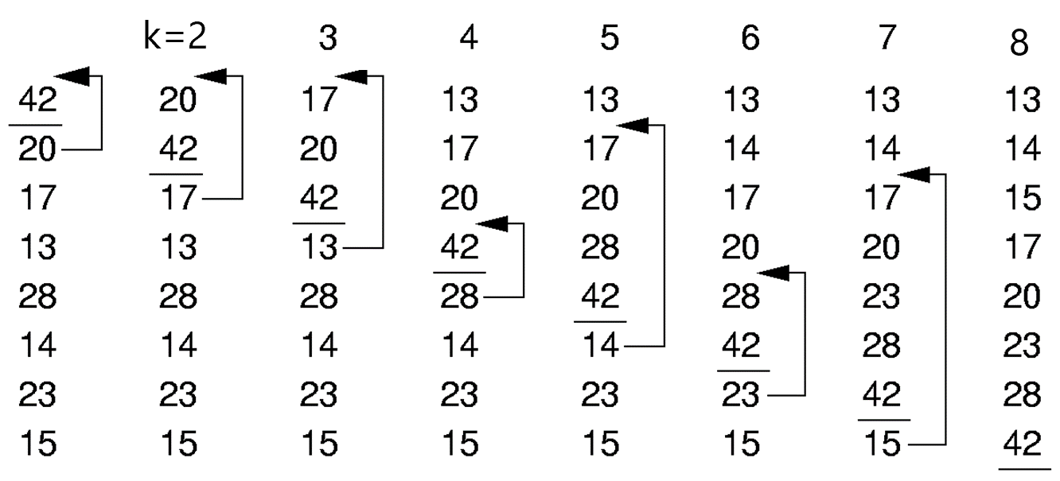
Example 2: Insertion Sort
Iteration k: repeatedly swap element k^{th} with the one to its left if smaller
Properties. After k^{th} iteration, A[0] through A[k] contain first k+1 elements in ascending order
k=1
A[0]
A[1]
A[2]
A[3]
A[4]
A[5]
A[6]
A[7]

Slide 45
Running time of Insertion sort: O(n²)
Properties: In place and Stable
Running time:
Best Case: O(n) when the input array is already sorted, or O(1) if only 1 element
Worst Case: O(n²), when the input array is in reverse order.
Average Case: O(n²)
When we should use insertion sort:
When the data sets are relatively small.
Moderately efficient.
When you want a quick easy implementation.
Not hard to code Insertion sort.
When data sets are mostly sorted already (each element is almost put very near its correct place in ordered array)
Example: (1, 2, 4, 6, 3, 2)

Slide 46
Contents
4.1. Insertion Sort
4.2. Selection Sort
4.3. Bubble Sort
4.4. Merge Sort
4.5. Quick Sort
4.6. Heap Sort

Slide 47
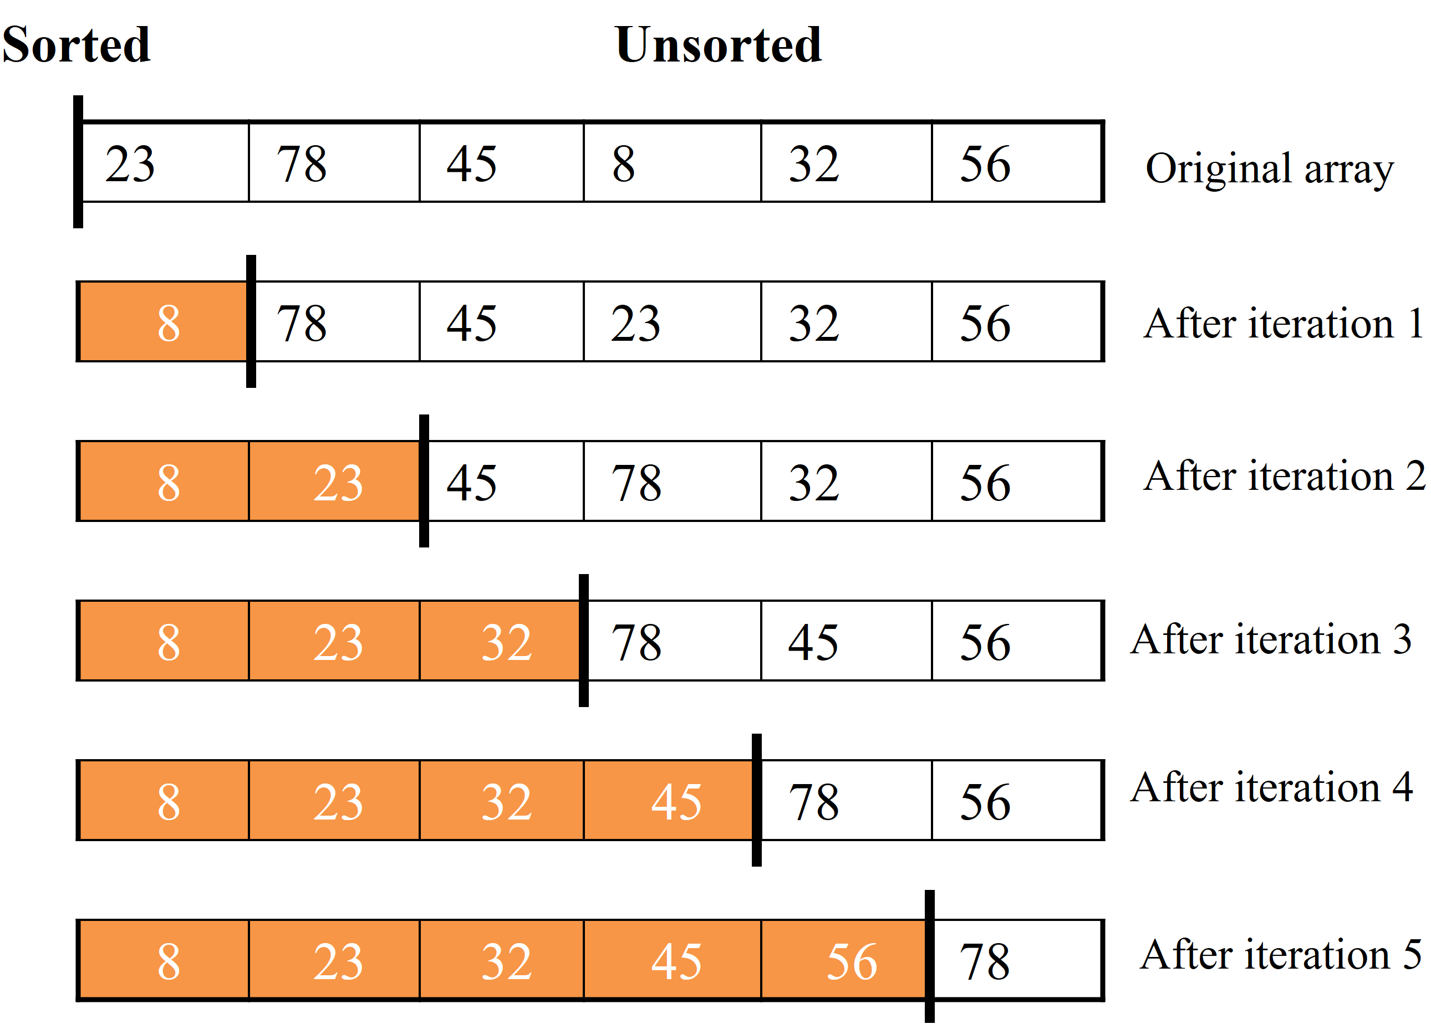
4.2. Selection sort
The array is divided into two subarrays, sorted and unsorted, which are divided by an imaginary wall.
Each iteration: We find the smallest element from the unsorted subarray and swap it with the element at the beginning of the unsorted subarray ➔ After each iteration (after each selection and swapping): the imaginary wall between the two subarrays move one element ahead, increasing the number of sorted elements and decreasing the number of unsorted ones.
An array of n elements requires n-1 iterations to completely sort the array.
At iteration i: find the smallest element among the unsorted elements a[i+1]…a[n-1] and put it at position i^{th}
Notes:
Imaginary: o* ,e

Slide 48
4.2. Selection sort
Algorithm:
The array is divided into two subarrays, sorted and unsorted, which are divided by an imaginary wall.
Each iteration: We find the smallest element from the unsorted subarray and swap it with the element at the beginning of the unsorted subarray ➔ After each iteration (after each selection and swapping), the imaginary wall between the two subarrays move one element ahead, increasing the number of sorted elements and decreasing the number of unsorted ones.
An array of n elements requires n-1 iterations to completely sort the array.
Find the smallest element and put it to 1st place of the array
Find the next smallest element, put it 2nd
Find the next smallest element, put it 3rd
…

Slide 49
4.2. Selection sort
void swap(int *a,int *b)
{
int temp = *a;
*a = *b;
*b = temp;
}
void selectionSort(int a[], int n){
int i, j, index_min;
for (i = 0; i < n-1; i++) {
index_min = i;
//Find the smallest element in the unsorted subarray: a[i+1] … a[n-1]
for (j = i+1; j < n; j++)
if (a[j] < a[index_min]) index_min = j;
//put a[index_min] to the i^{th} position
swap(&a[i], &a[index_min]);
}
}
At iteration i: find the smallest element among the unsorted elements a[i+1]…a[n-1] and put it at position i^{th}
Notes:
In selectionSort function, the outer for loop executes n-1 times.
We invoke swap function once at each iteration.
➔ Total Swaps: n-1
➔ Total Moves: 3*(n-1)
The inner for loop executes the size of the unsorted part minus 1 (from 1 to n-1), and in each iteration we make one key comparison.
➔ # of key comparisons = 1+2+...+n-1 = n*(n-1)/2
➔ So, Selection sort is O(n²)

Slide 50
Running time analysis
void swap(int *a,int *b)
{
int temp = *a;
*a = *b;
*b = temp;
}
void selectionSort(int a[], int n){
int i, j, index_min;
for (i = 0; i < n-1; i++) {
index_min = i;
//Find the smallest element in the unsorted subarray: a[i+1] … a[n-1]
for (j = i+1; j < n; j++)
if (a[j] < a[index_min]) index_min = j;
//put a[index_min] to the i^{th} position
swap(&a[i], &a[index_min]);
}
}
In selectionSort function: the outer for loop executes n-1 times.
We invoke swap function once at each iteration.
➔ Total Swaps: n-1
➔ Total Moves: 3*(n-1) since each swap, there are 3 moves
The inner for loop executes the size of the unsorted part minus 1 (from n-1 downto 1), and in each iteration we make one key comparison; therefore in total:
➔ # of key comparisons = (n-1) + (n-2) + …. + 2 + 1 = n*(n-1)/2
➔ So, Selection sort is O(n²)
Notes:
In selectionSort function, the outer for loop executes n-1 times.
We invoke swap function once at each iteration.
➔ Total Swaps: n-1
➔ Total Moves: 3*(n-1)
The inner for loop executes the size of the unsorted part minus 1 (from 1 to n-1), and in each iteration we make one key comparison.
➔ # of key comparisons = 1+2+...+n-1 = n*(n-1)/2
➔ So, Selection sort is O(n²)

Slide 51
Running time of Selection sort: O(n²)
Properties: In place and Stable
Running time: O(n²) for best/worse/average case. This means that the behavior of the selection sort algorithm does not depend on the initial organization of data.
Although the selection sort algorithm requires O(n²) key comparisons, it only requires O(n) moves.
A selection sort could be a good choice if data moves are costly but key comparisons are not costly (short keys, long records).
Notes:
Best: O(n²) Worst: O(n²) Average: O(n²)
Recurrence Relation: T(n) = n + T(N-1), T(1) = 1
Stable and In-Place

Slide 52
Contents
4.1. Insertion Sort
4.2. Selection Sort
4.3. Bubble Sort
4.4. Merge Sort
4.5. Quick Sort
4.6. Heap Sort

Slide 53
"Bubbling Up" the Largest Element
Traverse elements of array:
Move from the front to the end
“Bubble” the largest value to the end using pair-wise comparisons and swapping
a[0] a[1] a[2] a[3] a[4] a[5]
77
42
35
12
101
5

Slide 54
"Bubbling Up" the Largest Element
Traverse elements of array:
Move from the front to the end
“Bubble” the largest value to the end using pair-wise comparisons and swapping
a[0] a[1] a[2] a[3] a[4] a[5]
Swap
42
77
77
42
35
12
101
5

Slide 55
"Bubbling Up" the Largest Element
Traverse elements of array:
Move from the front to the end
“Bubble” the largest value to the end using pair-wise comparisons and swapping
a[0] a[1] a[2] a[3] a[4] a[5]
Swap
35
77
42
77
35
12
101
5

Slide 56
"Bubbling Up" the Largest Element
Traverse elements of array:
Move from the front to the end
“Bubble” the largest value to the end using pair-wise comparisons and swapping
a[0] a[1] a[2] a[3] a[4] a[5]
Swap
12
77
42
35
77
12
101
5

Slide 57
"Bubbling Up" the Largest Element
Traverse elements of array:
Move from the front to the end
“Bubble” the largest value to the end using pair-wise comparisons and swapping
a[0] a[1] a[2] a[3] a[4] a[5]
42
35
12
77
101
5
No need to swap

Slide 58
"Bubbling Up" the Largest Element
Traverse elements of array:
Move from the front to the end
“Bubble” the largest value to the end using pair-wise comparisons and swapping
a[0] a[1] a[2] a[3] a[4] a[5]
Swap
5
101
42
35
12
77
101
5

Slide 59
"Bubbling Up" the Largest Element
Traverse elements of array:
Move from the front to the end
“Bubble” the largest value to the end using pair-wise comparisons and swapping
a[0] a[1] a[2] a[3] a[4] a[5]
101
42
35
12
77
5
Largest value correctly placed

Slide 60
Items of Interest
Notice that only the largest value is correctly placed
All other values are still out of order
So we need to repeat this process
a[0] a[1] a[2] a[3] a[4] a[5]
101
42
35
12
77
5
Largest value correctly placed

Slide 61
Repeat “Bubble Up” How Many Times?
If we have n elements…
And if each time we bubble an element, we place it in its correct location…
Then we repeat the “bubble up” process n – 1 times.
This guarantees we’ll correctly place all n elements.

Slide 62
“Bubbling” All the Elements
a[0] a[1] a[2] a[3] a[4] a[5]
77
42
35
12
101
5
Original array
42
35
12
77
5
101
1st iteration
35
12
42
5
77
101
2nd iteration
n - 1
12
35
5
42
77
101
3rd iteration
12
5
35
42
77
101
4th iteration
5
12
35
42
77
101
5th iteration

Slide 63
Example: Sort array: 9, 6, 2, 12, 11, 9, 3, 7
9, 6, 2, 12, 11, 9, 3, 7
Bubble sort compares the numbers in pairs from left to right, and exchanging when necessary. Here the first number is compared to the second and as it is larger they are exchanged.

Slide 64
Bubble Sort Example
9, 6, 2, 12, 11, 9, 3, 7
6, 9, 2, 12, 11, 9, 3, 7
Now the next pair of numbers are compared. Again the 9 is the larger than the 2, and so this pair is also exchanged.

Slide 65
Bubble Sort Example
9, 6, 2, 12, 11, 9, 3, 7
6, 9, 2, 12, 11, 9, 3, 7
6, 2, 9, 12, 11, 9, 3, 7
In the third comparison, the 9 is not larger than the 12 so no exchange is made. We move on to compare the next pair without any change to the array.

Slide 66
Bubble Sort Example
9, 6, 2, 12, 11, 9, 3, 7
6, 9, 2, 12, 11, 9, 3, 7
6, 2, 9, 12, 11, 9, 3, 7
6, 2, 9, 12, 11, 9, 3, 7
The 12 is larger than the 11 so they are exchanged.

Slide 67
Bubble Sort Example
9, 6, 2, 12, 11, 9, 3, 7
6, 9, 2, 12, 11, 9, 3, 7
6, 2, 9, 12, 11, 9, 3, 7
6, 2, 9, 12, 11, 9, 3, 7
6, 2, 9, 11, 12, 9, 3, 7
The 12 is greater than the 9 so they are exchanged

Slide 68
Bubble Sort Example
9, 6, 2, 12, 11, 9, 3, 7
6, 9, 2, 12, 11, 9, 3, 7
6, 2, 9, 12, 11, 9, 3, 7
6, 2, 9, 12, 11, 9, 3, 7
6, 2, 9, 11, 12, 9, 3, 7
6, 2, 9, 11, 9, 12, 3, 7
The 12 is greater than the 3 so they are exchanged.

Slide 69
Bubble Sort Example
9, 6, 2, 12, 11, 9, 3, 7
6, 9, 2, 12, 11, 9, 3, 7
6, 2, 9, 12, 11, 9, 3, 7
6, 2, 9, 12, 11, 9, 3, 7
6, 2, 9, 11, 12, 9, 3, 7
6, 2, 9, 11, 9, 12, 3, 7
6, 2, 9, 11, 9, 3, 12, 7
The 12 is greater than the 7 so they are exchanged.

Slide 70
Bubble Sort Example
9, 6, 2, 12, 11, 9, 3, 7
6, 9, 2, 12, 11, 9, 3, 7
6, 2, 9, 12, 11, 9, 3, 7
6, 2, 9, 12, 11, 9, 3, 7
The end of the array has been reached so this is the end of the first iteration. The twelve at the end of the array must be largest number in the array and so is now in the correct position. We now start a new iteration from left to right.
6, 2, 9, 11, 12, 9, 3, 7
6, 2, 9, 11, 9, 12, 3, 7
6, 2, 9, 11, 9, 3, 12, 7
6, 2, 9, 11, 9, 3, 7, 12

Slide 71
Example: Sort array: 9, 6, 2, 12, 11, 9, 3, 7
6, 2, 9, 11, 9, 3, 7, 12
1st iteration:
6, 2, 9, 11, 9, 3, 7, 12
2, 6, 9, 11, 9, 3, 7, 12
2, 6, 9, 9, 11, 3, 7, 12
2, 6, 9, 9, 3, 11, 7, 12
2, 6, 9, 9, 3, 7, 11, 12
2nd iteration:
Notice that this time we do not have to compare the last two numbers as we know the 12 is in position. This iteration therefore only requires 6 comparisons.

Slide 72
Bubble Sort Example
6, 2, 9, 11, 9, 3, 7, 12
1st iteration:
2, 6, 9, 9, 3, 7, 11, 12
2nd iteration:
2, 6, 9, 9, 3, 7, 11, 12
2, 6, 9, 3, 9, 7, 11, 12
2, 6, 9, 3, 7, 9, 11, 12
3rd iteration:
This time the 11 and 12 are in position. This iteration therefore only requires 5 comparisons.

Slide 73
Bubble Sort Example
6, 2, 9, 11, 9, 3, 7, 12
1st iteration:
2, 6, 9, 9, 3, 7, 11, 12
2nd iteration:
2, 6, 9, 3, 7, 9, 11, 12
3rd iteration:
2, 6, 9, 3, 7, 9, 11, 12
2, 6, 3, 9, 7, 9, 11, 12
2, 6, 3, 7, 9, 9, 11, 12
4th iteration:
Each iteration requires fewer comparisons. This time only 4 are needed.

Slide 74
Bubble Sort Example
6, 2, 9, 11, 9, 3, 7, 12
1st iteration:
2, 6, 9, 9, 3, 7, 11, 12
2nd iteration:
2, 6, 9, 3, 7, 9, 11, 12
3rd iteration:
2, 6, 3, 7, 9, 9, 11, 12
4th iteration:
2, 6, 3, 7, 9, 9, 11, 12
2, 3, 6, 7, 9, 9, 11, 12
5th iteration:
The array is now sorted but the algorithm does not know this until it completes an iteration with no exchanges.

Slide 75
Bubble Sort Example
6, 2, 9, 11, 9, 3, 7, 12
1st iteration:
2, 6, 9, 9, 3, 7, 11, 12
2nd iteration:
2, 6, 9, 3, 7, 9, 11, 12
3rd iteration:
2, 6, 3, 7, 9, 9, 11, 12
4th iteration:
2, 3, 6, 7, 9, 9, 11, 12
5th iteration:
2, 3, 6, 7, 9, 9, 11, 12
6th iteration:
This iteration no exchanges are made so the algorithm knows the array is sorted. It can therefore save time by not doing the final iteration. With other arrays this check could save much more work.

Slide 76
Quiz time
Which number is definitely in its correct position at the end of the first iteration?
Answer: The last number must be the largest.
How does the number of comparisons required change as the iteration number increases?
Answer: Each iteration requires one fewer comparison than the last.
How does the algorithm know when the array is sorted?
Answer: When an iteration with no exchanges occurs.
What is the maximum number of comparisons required for an array of 10 numbers?
Answer: 9 comparisons, then 8, 7, 6, 5, 4, 3, 2, 1 so total 45.

Slide 77
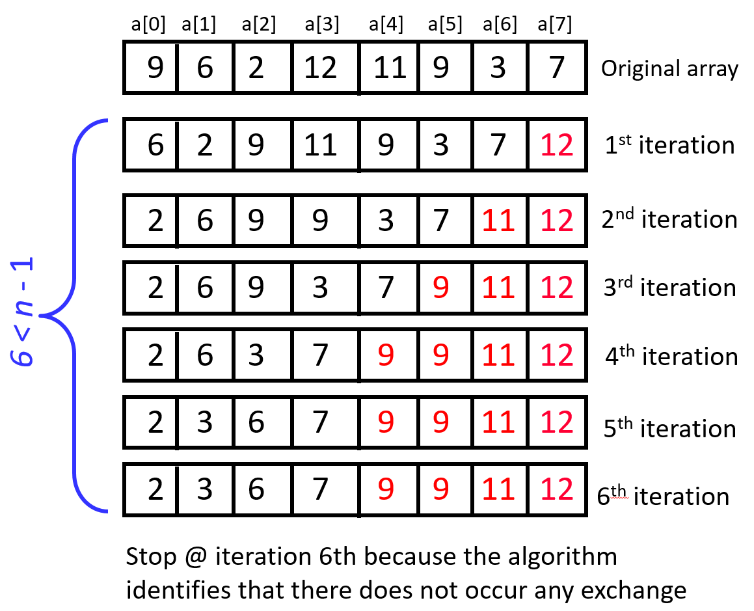
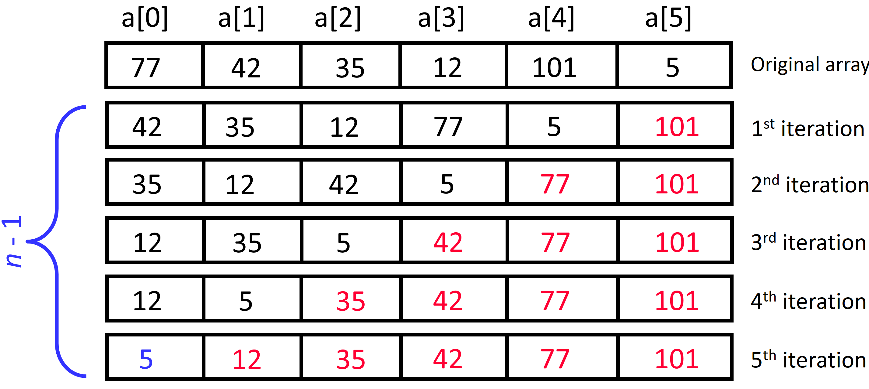
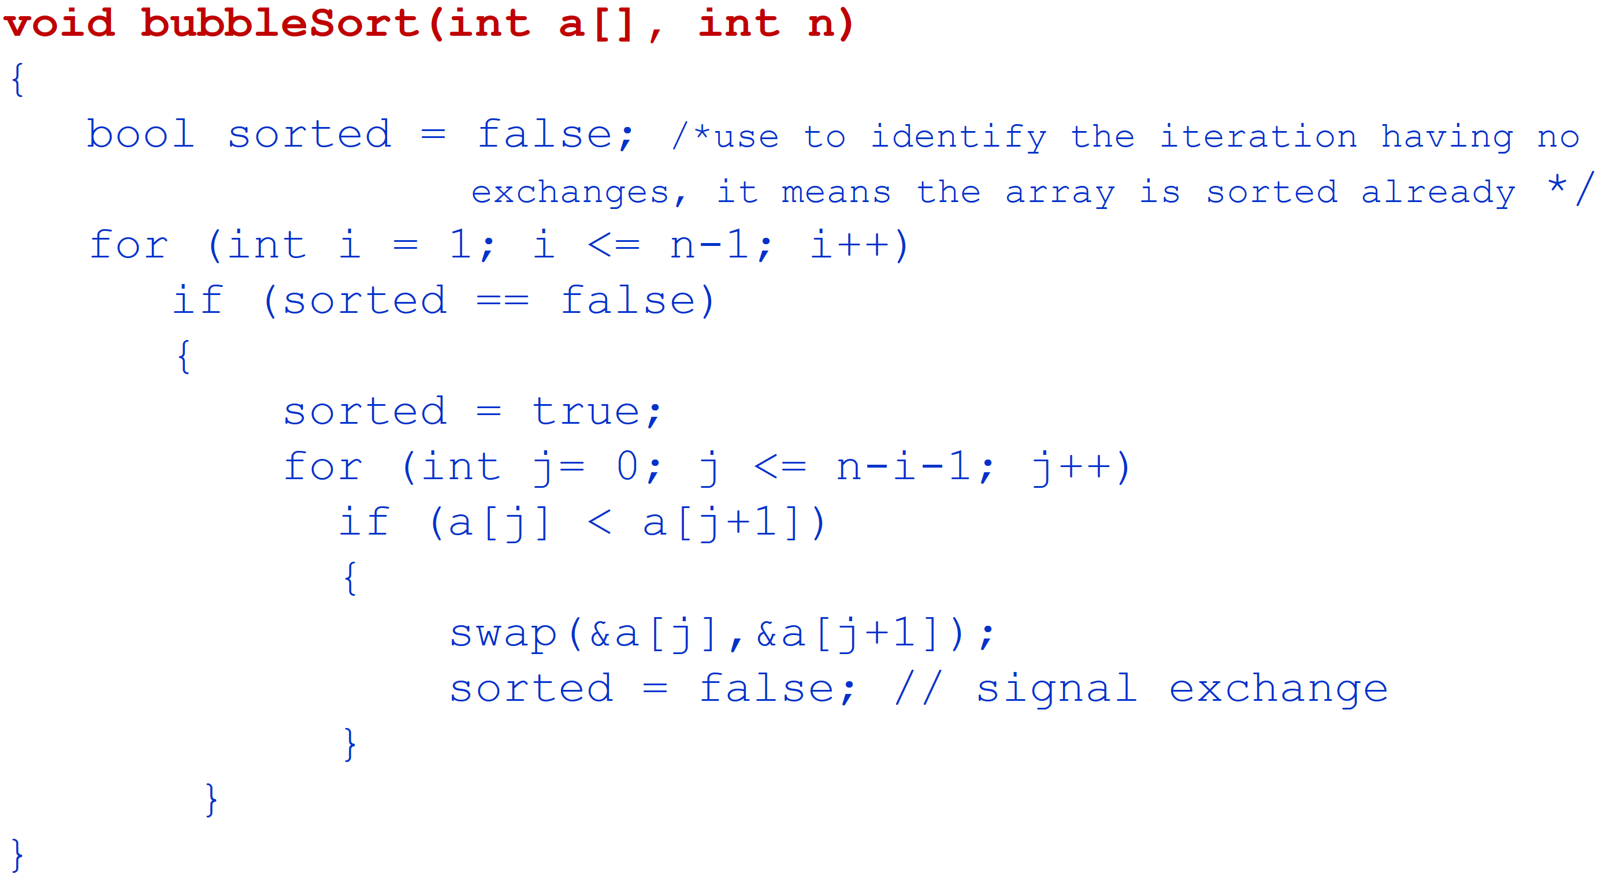
4.3. Bubble Sort: implementation
Apply bubble sort to sort this array of n numbers: a[0], a[1], …a[n-1]:
The algorithm stops when it identifies that the array is already sorted (@ iteration in which there does not occur any exchange)
The maximum number of iterations = n – 1
Each iteration i (i=1,2,..,n-1): bubble the largest number among elements a[0]…a[n-i] to the last position (n-i)

Slide 78
4.3. Bubble Sort: implementation
void bubbleSort(int a[], int n)
{
bool sorted = false; /*use to identify the iteration having no
exchanges, it means the array is sorted already */
for (int i = 1; i <= n-1; i++)
if (sorted == false)
{
sorted = true;
for (int j= 0; j <= n-i-1; j++)
if (a[j] < a[j+1])
{
swap(&a[j],&a[j+1]);
sorted = false; // signal exchange
}
}
}

Slide 79
4.3. Bubble Sort – Analysis
Best-case: O(n)
Array is already sorted in ascending order.
The number of moves: 0 ➔ O(1)
The number of key comparisons: (n-1)➔ O(n)
Worst-case: O(n²)
Array is in reverse order: outer loop is executed n-1 times,
The number of moves: 3*(1+2+...+n-1) = 3 * n*(n-1)/2 ➔ O(n²)
The number of key comparisons: (1+2+...+n-1)= n*(n-1)/2 ➔ O(n²)
Average-case: O(n²)
We have to look at all possible initial data organizations.
So, Bubble Sort is O(n²)
Notes:
The number of moves: 3*(1+2+…+(n-1)) ➔ 3 because of each swap requires 3 moves

Slide 80
Contents
4.1. Insertion Sort
4.2. Selection Sort
4.3. Bubble Sort
4.4. Merge Sort
4.5. Quick Sort
4.6. Heap Sort
O(n²)
Divide and conquer

Slide 81
Divide-and-Conquer
Divide-and conquer is a general algorithm design paradigm:
Divide: divide the input data S in two disjoint subsets S₁ and S₂
Conquer: solve the sub problems associated with S₁ and S₂
Combine: combine the solutions for S₁ and S₂ into a solution for S
The base case for the recursion are sub problems of size 0 or 1
Merge-sort and quick sort are sorting algorithms based on the divide-and-conquer paradigm

Slide 82
4.4. Merge Sort
Problem: Sorting n elements of an array S[0]…S[n-1]
Merge-sort on an input sequence S with n elements consists of three steps:
Divide: partition S into two sequences S₁ and S₂ of about n/2 elements each
Conquer: recursively sort S₁ and S₂by using merge sort
Combine: merge S₁ and S₂ into a unique sorted sequence

Slide 83
4.4.Merge Sort
p
q
r
0
1
2
3
4
5
6
7
MS(S, p, r)
if p < r then Check the base case
q ← ⎣(p + r)/2⎦ Divide
MS(S, p, q) Conquer
MS(S, q + 1, r) Conquer
MERGE(S, p, q, r) Combine
endif
The statement to sort array S of n elements: MS(S, 0, n-1);
5
2
4
7
1
3
2
6

Slide 84
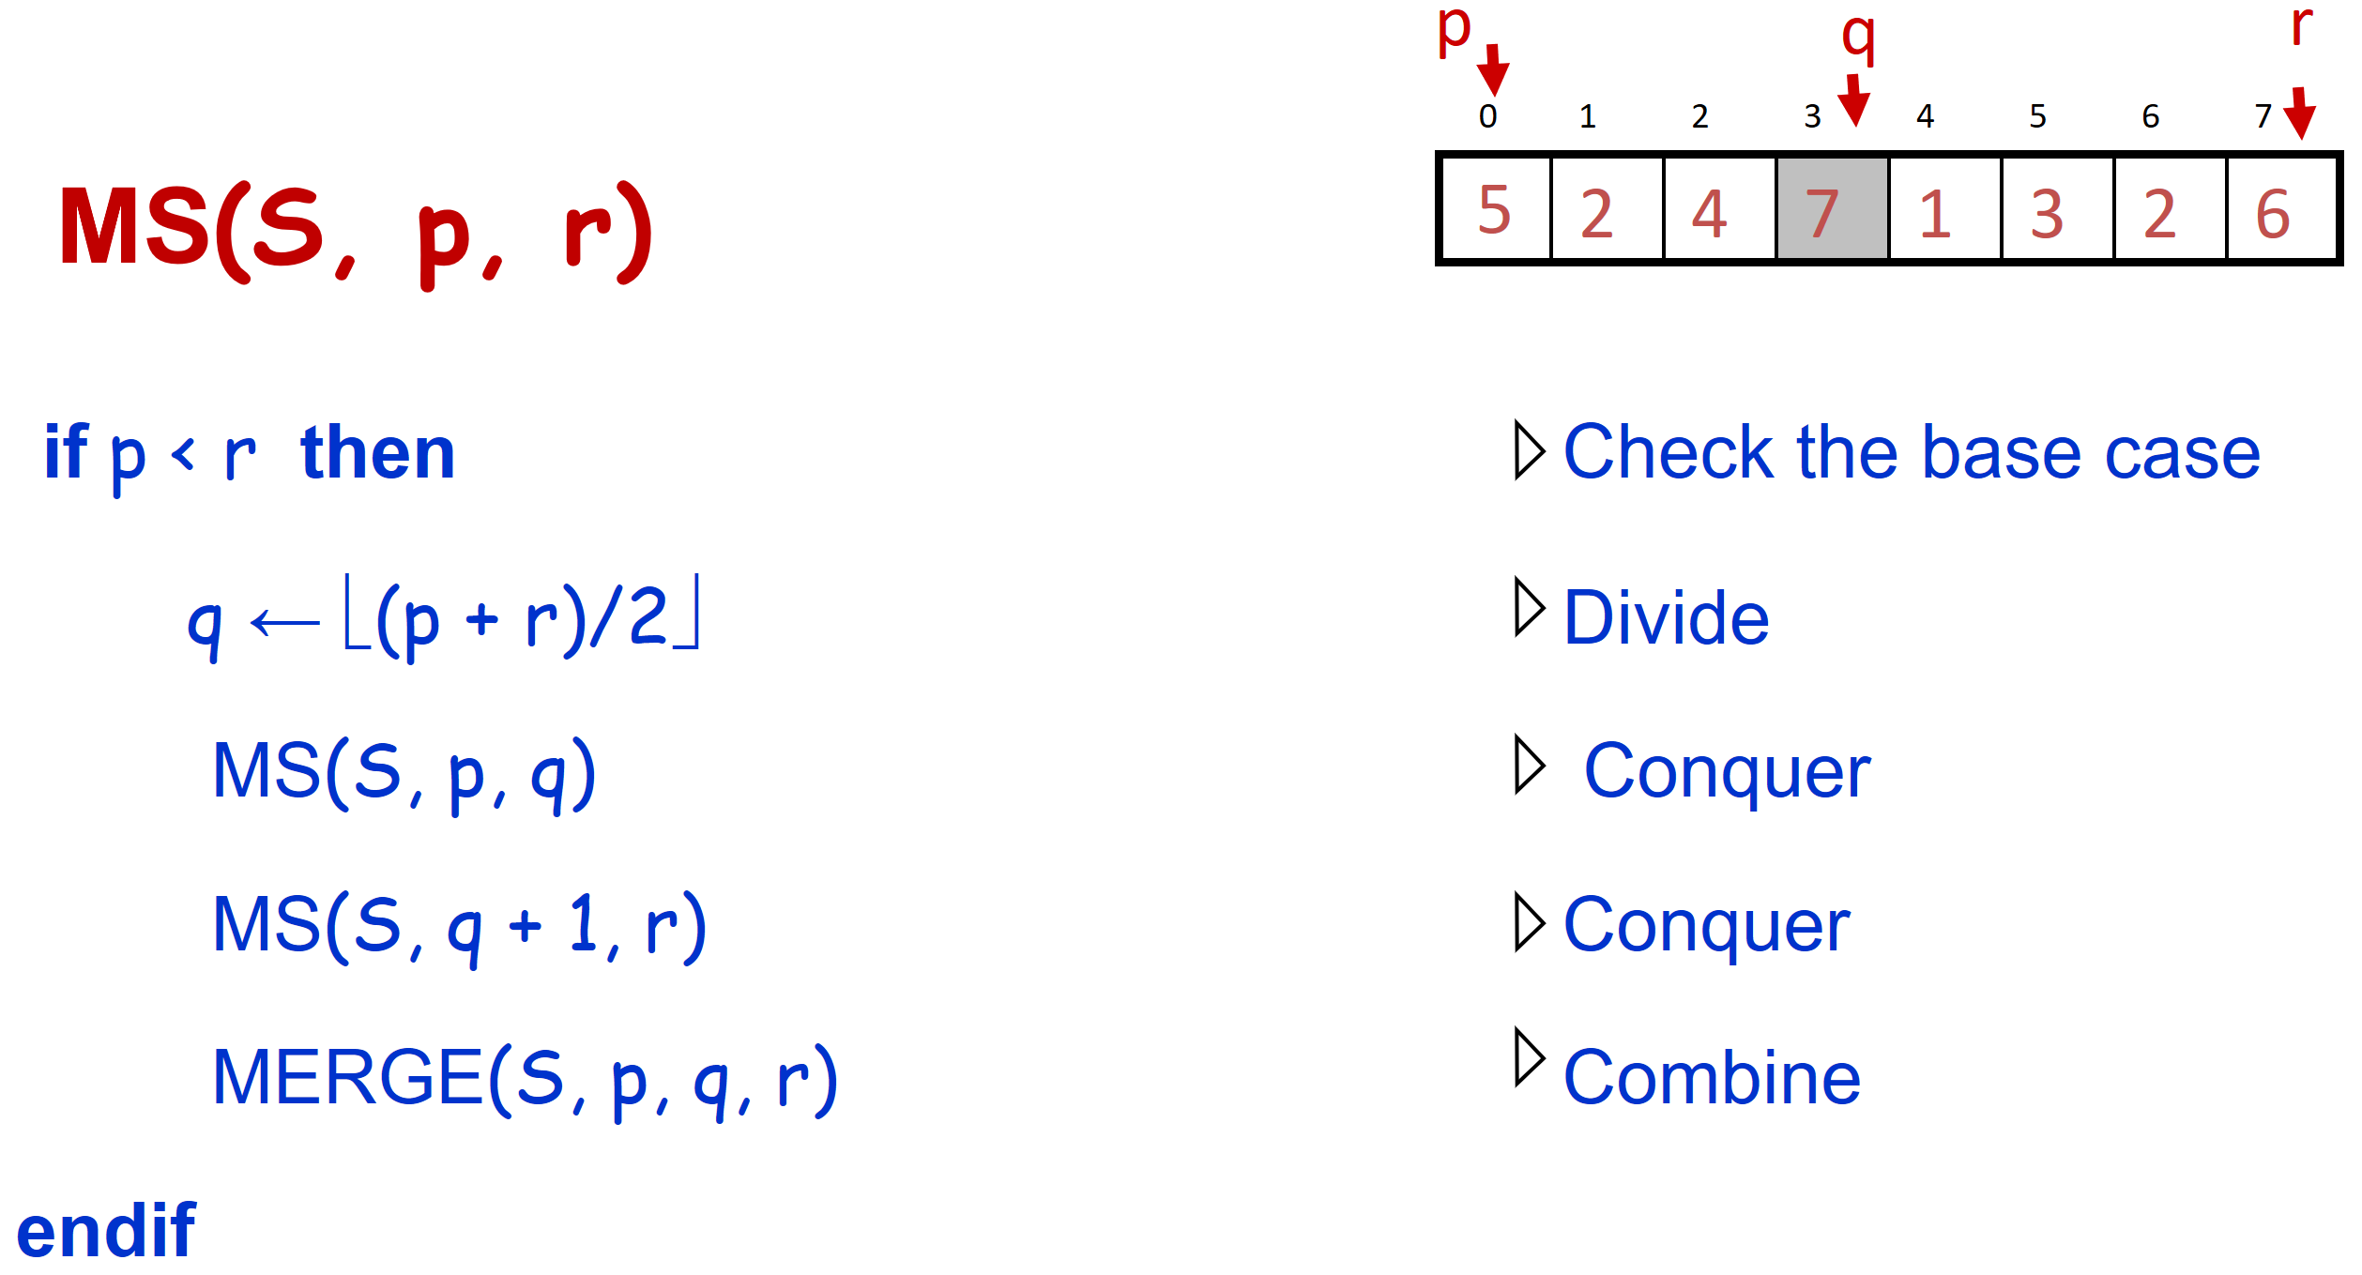
Example: Merge sort
0
1
2
3
4
5
6
7
8
2
9
4
5
3
1
6
0
1
2
3
4
5
6
7
Divide
8
2
9
4
5
3
1
6
0
1
2
3
4
5
6
7
Divide
8
2
9
4
5
3
1
6
0
1
2
3
4
5
6
7
1 element
8
2
9
4
5
3
1
6
0
1
2
3
4
5
6
7
Merge
2
8
4
9
3
5
1
6
0
1
2
3
4
5
6
7
Merge
2
4
8
9
1
3
5
6
0
1
2
3
4
5
6
7
Result:
1
2
3
4
5
6
8
9

Slide 85
Example: Merge sort
MS(S, 0, 7);
0
1
2
3
4
5
6
7
p=0;r=7: q = 3
MS(S,0,3);MS(S,4,7);
MERGE(S,0,3,7);
8
2
9
4
5
3
1
6
MS(S,0,3)
MS(S,4,7)
0
1
2
3
4
5
6
7
p=0;r=3: q = 1
MS(S,0,1); MS(S,2,3);
MERGE(S,0,1,3);
p=4;r=7: q = 5
MS(S,4,5); MS(S,6,7);
MERGE(S,4,5,7);
Divide
8
2
9
4
5
3
1
6
MS(S,0,1)
MS(S,2,3)
MS(S,4,5)
MS(S,6,7)
p=0;r=1: q = 0
MS(S,0,0);MS(S,1,1);
MERGE(S,0,0,1);
0
1
2
3
4
5
6
7
Divide
p=2;r=3: q = 2
MS(S,2,2);MS(S,3,3);
MERGE(S,2,2,3);
p=4;r=5: q = 4
MS(S,4,4);MS(S,5,5);
MERGE(S,4,4,5);
p=6;r=7: q = 6
MS(S,6,6); MS(S,7,7);
MERGE(S,6,6,7);
8
2
9
4
5
3
1
6
MS(S,0,0)
MS(S,1,1)
MS(S,2,2)
MS(S,3,3)
MS(S,4,4)
MS(S,5,5)
MS(S,6,6)
MS(S,7,7)
1 element
p=0;r=0:
0
1
p=1;r=1
p=2;r=2:
2
3
p=3;r=3
4
5
p=5;r=5
p=6;r=6
6
7
p=7;r=7
8
2
9
4
p=4;r=4
5
3
1
6
MERGE(S,0,0,1)
MERGE(S,2,2,3)
MERGE(S,4,4,5)
MERGE(S,6,6,7)
0
1
2
3
4
5
6
7
Merge
2
8
4
9
3
5
1
6
MERGE(S,0,1,3)
MERGE(S,4,5,7)
0
1
2
3
4
5
6
7
Merge
2
4
8
9
1
3
5
6
MERGE(S,0,3,7)
0
1
2
3
4
5
6
7
Result:
1
2
3
4
5
6
8
9

Slide 86
4.4.Merge Sort
p
q
r
0
1
2
3
4
5
6
7
MS(S, p, r)
if p < r then Check the base case
q ← ⎣(p + r)/2⎦ Divide
MS(S, p, q) Conquer
MS(S, q + 1, r) Conquer
MERGE(S, p, q, r) Combine
endif
5
2
4
7
1
3
2
6
Merge 2 ordered subarrays S[p]...S[q] and S[q+1]...S[r] into one array that is ordered in ascending order

Slide 87
Merge 2 ordered subarrays S[p]...S[q] and S[q+1]...S[r] into one array that is ordered in ascending order
p
q
r
Array S consists of 2 ordered halves:
Subarray 1: consists of elements S[p]… S[q]
Subarray 2: consists of elements S[q+1]… S[r]
We need to merge these 2 subarrays to get an array that is ordered in ascending order:
We used 2 extra subarrays L, R with size = ½ size of array S
0
1
2
3
4
5
6
7
S
2
4
8
9
1
3
5
6
Array: L← S[p],…,S[q]
S[p, r]
Array R← S[q+1],…,S[r]
87
At the same time, browse 2 subarrays (L and R) from the beginning to the end: choose smaller element from 2 subarrays to insert into array S.
S
…
6
8
26
32
1
9
42
43
…
1
6
8
9
26
32
42
43
k
k
k
k
k
k
k
k
L
6
8
26
32
R
6
8
26
32
∞
1
9
42
43
1
9
42
43
∞
k
j
j
i
j
i
j
i
j
i
i

Slide 88
Merge - Pseudocode
p
q
r
0
1
2
3
4
5
6
7
S
2
4
8
9
1
3
5
6
MERGE(S, p, q, r)
Calculate n₁ and n₂
Copy the first n₁ elements to L[1 . . n₁] and remain n₂ elements to R[1 . . n₂]
L[n₁ + 1] ← ∞; R[n₂ + 1] ← ∞
i ← 1; j ← 1
for k ← p to r do
if L[ i ] ≤ R[ j ]
then S[k] ← L[ i ]
i ←i + 1
else S[k] ← R[ j ]
j ← j + 1
n₁
n₂
i
p
q
L
2
4
8
9
∞
j
q + 1
r
R
1
2
5
6
∞
k=p
r
S
1

Slide 89
Merge - Pseudocode
p
q
r
1
2
3
4
5
6
7
8
S
2
4
8
9
1
3
5
6
MERGE(S, p, q, r)
Calculate n₁ and n₂
Copy the first n₁ elements to L[1 . . n₁] and remain n₂ elements to R[1 . . n₂]
L[n₁ + 1] ← ∞; R[n₂ + 1] ← ∞
i ← 1; j ← 1
for k ← p to r do
if L[ i ] ≤ R[ j ]
then S[k] ← L[ i ]
i ←i + 1
else S[k] ← R[ j ]
j ← j + 1
n₁
n₂
i
p
q
L
2
4
8
9
∞
j
q + 1
r
R
1
2
5
6
∞
k=p
r
S
1
2

Slide 90
Merge - Pseudocode
p
q
r
1
2
3
4
5
6
7
8
S
2
4
8
9
1
3
5
6
MERGE(S, p, q, r)
Calculate n₁ and n₂
Copy the first n₁ elements to L[1 . . n₁] and remain n₂ elements to R[1 . . n₂]
L[n₁ + 1] ← ∞; R[n₂ + 1] ← ∞
i ← 1; j ← 1
for k ← p to r do
if L[ i ] ≤ R[ j ]
then S[k] ← L[ i ]
i ←i + 1
else S[k] ← R[ j ]
j ← j + 1
n₁
n₂
i
p
q
L
2
4
8
9
∞
j
q + 1
r
R
1
2
5
6
∞
k
r
p
S
1
2
2
4
5
6
8
9

Slide 91
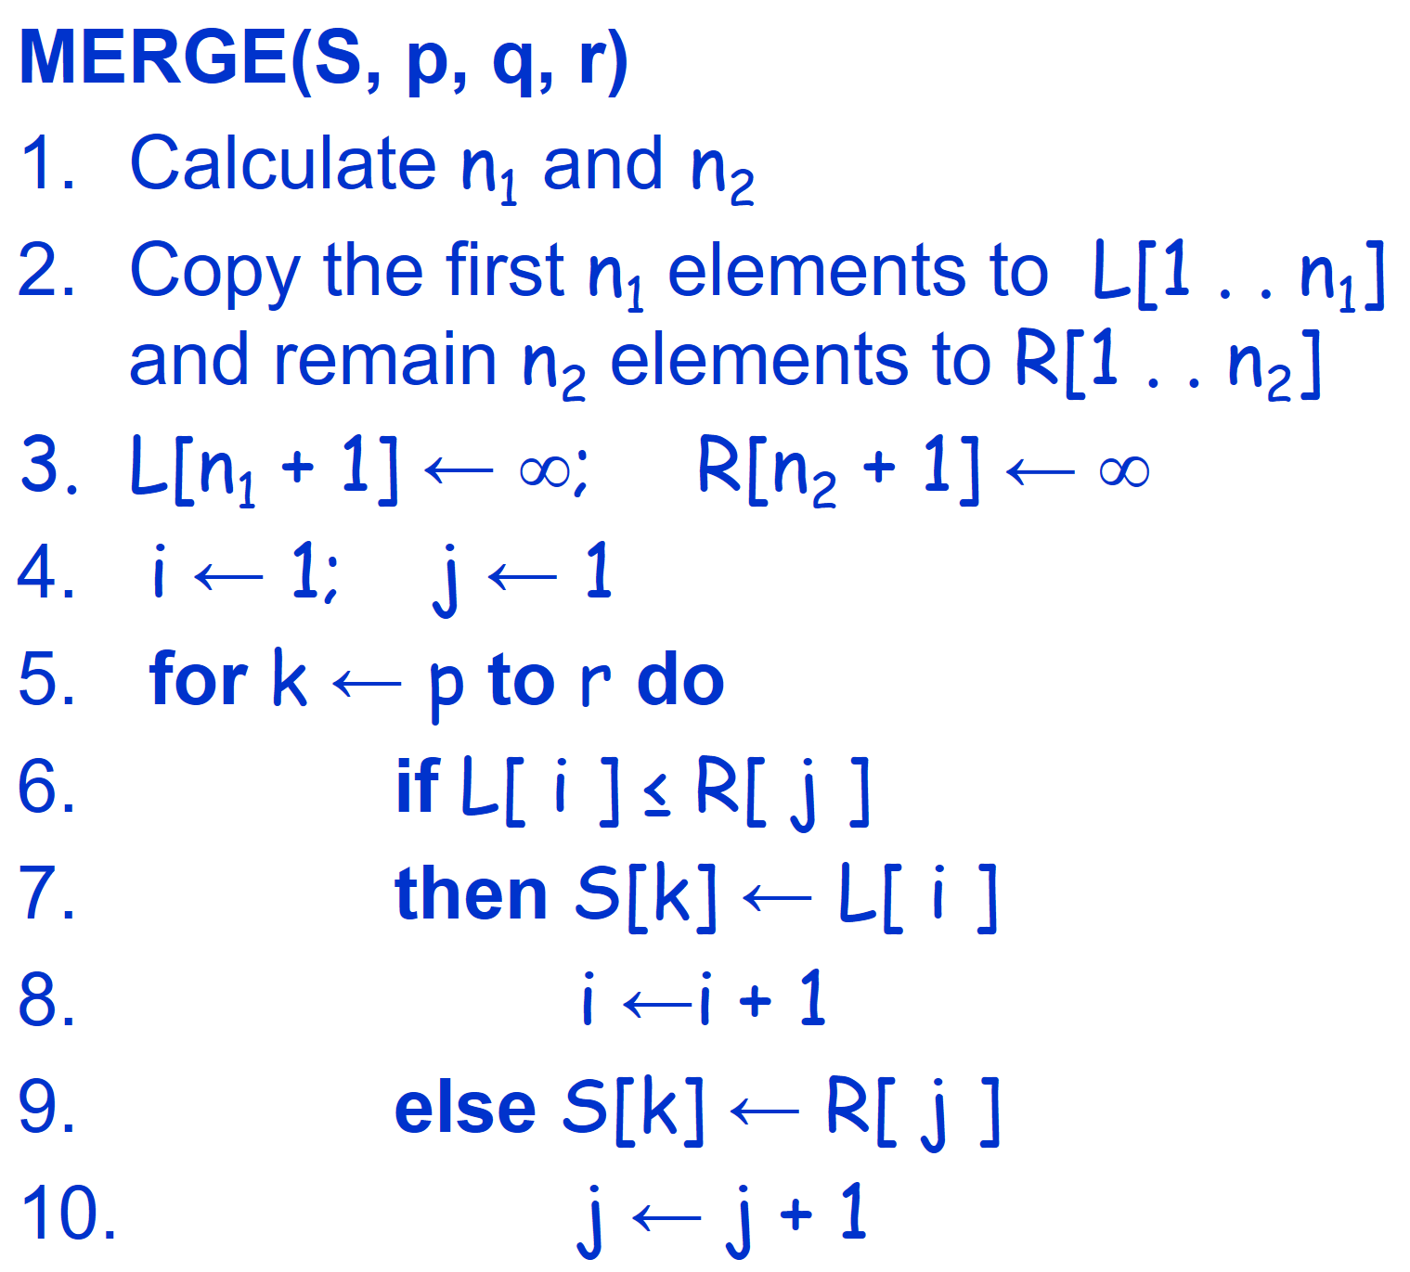
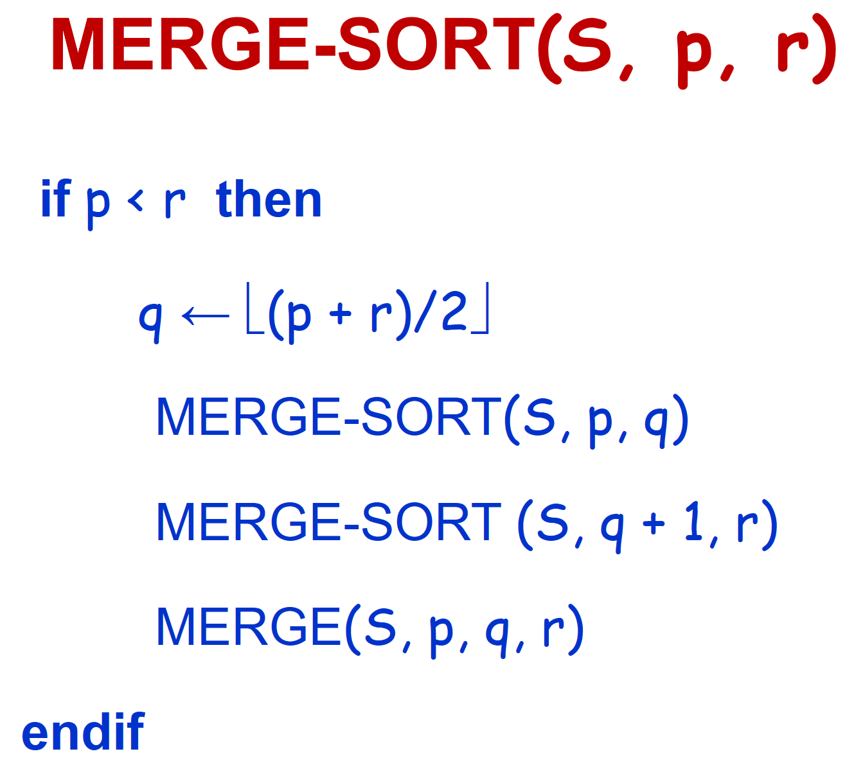
Computation time analysis Merge sort: O(nlogn)
Running time of Merge procedure:
Initialize (create 2 subarrays L and R):
O(n₁ + n₂) = O(n)
Insert elements into array S (the loop for):
n loops, each loop requires constant time ⇒ O(n)
Total running time of Merge procedure: O(n)
Running time of Merge Sort:
Divide: calculate q as the average of p and r: O(1)
Conquer: solve 2 sub problems with size n/2 each ⇒ 2T (n/2)
Combine: MERGE 2 sub arrays of n elements requires O(n)
O(1) if n =1
T(n) = 2T(n/2) + O(n) if n > 1
Therefore: T(n) = O(n log n)

Slide 92
Contents
4.1. Insertion Sort
4.2. Selection Sort
4.3. Bubble Sort
4.4. Merge Sort
4.5. Quick Sort
4.6. Heap Sort
O(n²)
Divide and conquer

Slide 93
4.5. Quick sort
The quick sort algorithm is described recursively as following (similar to merge sort):
Base case. If the array has only one element, then the array is sorted already, return it without doing anything.
Divide:
Select an element in the array, and call it as the pivot p.
Divide the array into 2 subarrays: Left subarray (L) consists of elements ≤ the pivot, right subarray (R) consists of elements ≥ the pivot. This operation is called “Partition”.
Conquer: recursively call QuickSort for 2 subarrays L = A[p…q] and R = A[q+1…r].
Combine: The sorted array is L p R.
In contrast to Merge Sort, in Quick Sort: division operation is complicate, but the Partition operation is simple.
Notes:
Combine
Trivial: the arrays are sorted in place
No additional work is required to combine them
The entire array is now sorted

Slide 94
4.5.Quick sort: Example
A
Select pivot
81
43
31
57
13
75
92
0
65
26
L
R
Divide array S into 2 subarrays:
Left half: consists of elements <=pivot
Right half: consists of elements >= pivot
0
31
75
13
43
65
92
81
26
57
L
R
QuickSort(L) and
QuickSort(R)
0
13
26
31
43
57
65
75
81
92
A
OK! A is sorted
0
13
26
31
43
57
65
75
81
92

Slide 95
4.5. Quick sort diagram
Quick-Sort(A, Left, Right)
if (Left < Right ) {
Pivot = Partition(A, Left, Right);
Quick-Sort(A, Left, Pivot –1);
Quick-Sort(A, Pivot +1, Right);
}
Function Partition(A, Left, Right) divides A[Left..Right] into 2 subarrays A[Left..Pivot –1 ] and A[Pivot+1..Right] such that:
Elements of A[Left..Pivot –1] is less than or equal to A[Pivot]
Elements of A[Pivot+1..Right] is greater than or equal to A[Pivot].
The statement to sort array A consists of n elements: Quick-Sort(A, 0, n-1)

Slide 96
Partition operation
Function Partition(A, left, right) :
Input: Array A[left .. right].
Output: Redistribute elements of the array A based on the selected pivot element and return the jpivot index to satisfy:
a[jpivot] has the value = pivot,
a[i] ≤ a[jpivot], with left ≤ i < jpivot,
a[j] ≥ a[jpivot]), with jpivot < j ≤ right.
where pivot is the value of selected pivot element
Input
9
1
11
17
13
4
5
8
Example: select pivot as the first element of array
A[left…jpivot]
≤
≥
A[jpivot+1…right]
A[left…jpivot]
≤
≥
A[jpivot+1…right]
Output
1
4
5
8
9
11
13
17
Output
A[jpivot]=pivot
A[jpivot]=pivot
Notes:
Redistribute elements of the input array based on the selected pivot element and return the jpivot index to satisfy:

Slide 97
The pivot is the first element of array
The function Partition moves elements of the array A[left]…..A[right] to obtain a new
array such that:
The pivot element goes to its final position (denoted as j^{th} position) in the sorted array
Elements from A [left] ... A [j-1] are <= the pivot
Elements from A [j + 1] ... A [right] are > = the pivot
A[left]
A[right]
Initial
pivot
left
right
During partition
pivot | ≤ pivot |  | ≥ pivot
i
j
Finish partition
≤ pivot | pivot | ≥ pivot
left
A[j]
right
Notes:
We use the following general strategy: First, we arbitrarily choose a[lo] to be the partitioning item—the one that will go into its final position. Next, we scan from the left end of the array until we find an entry that is greater than (or equal to) the partitioning item, and we scan from the right end of the array until we find an entry less than (or equal to) the partitioning item.
The two items that stopped the scans are out of place in the final partitioned array, so we exchange them. When the scan indices cross, all that we need to do to complete the partitioning process is to exchange the partitioning item a[lo] with the rightmost entry of the left subarray (a[j]) and return its index j.

Slide 98
The pivot is the first element of array
A[left]
A[right]
Initial
pivot
left
right
During partition
pivot | ≤ pivot |  | ≥ pivot
i
j
Finish partition
≤ pivot | pivot | ≥ pivot
left
A[j]
right
Select the first element of the array as the pivot: pivot = A[left] (when finish the function Partition, the pivot element is set to the position j^{th} which is its final position in the final sorted array A)
i = left +1; Scan left: Scan from element A[i] to the end of the array until we find the element FIRST1 >= pivot
j=right; Scan right: Scan from element A[j] to the beginning of the array until we find the element FIRST2 <= pivot
SWAP (FIRST1, FIRST2) because they are out of place in the final sorted array
Continue scanning from left and right to swap elements if necessary, stop scanning when i >= j
Finally, SWAP(A[left] = pivot, A[j]) – swap the pivot element with the last element of left subarray
return j
Notes:
We use the following general strategy: First, we arbitrarily choose a[lo] to be the partitioning item—the one that will go into its final position. Next, we scan from the left end of the array until we find an entry that is greater than (or equal to) the partitioning item, and we scan from the right end of the array until we find an entry less than (or equal to) the partitioning item.
The two items that stopped the scans are out of place in the final partitioned array, so we exchange them. When the scan indices cross, all that we need to do to complete the partitioning process is to exchange the partitioning item a[lo] with the rightmost entry of the left subarray (a[j]) and return its index j.

Slide 99
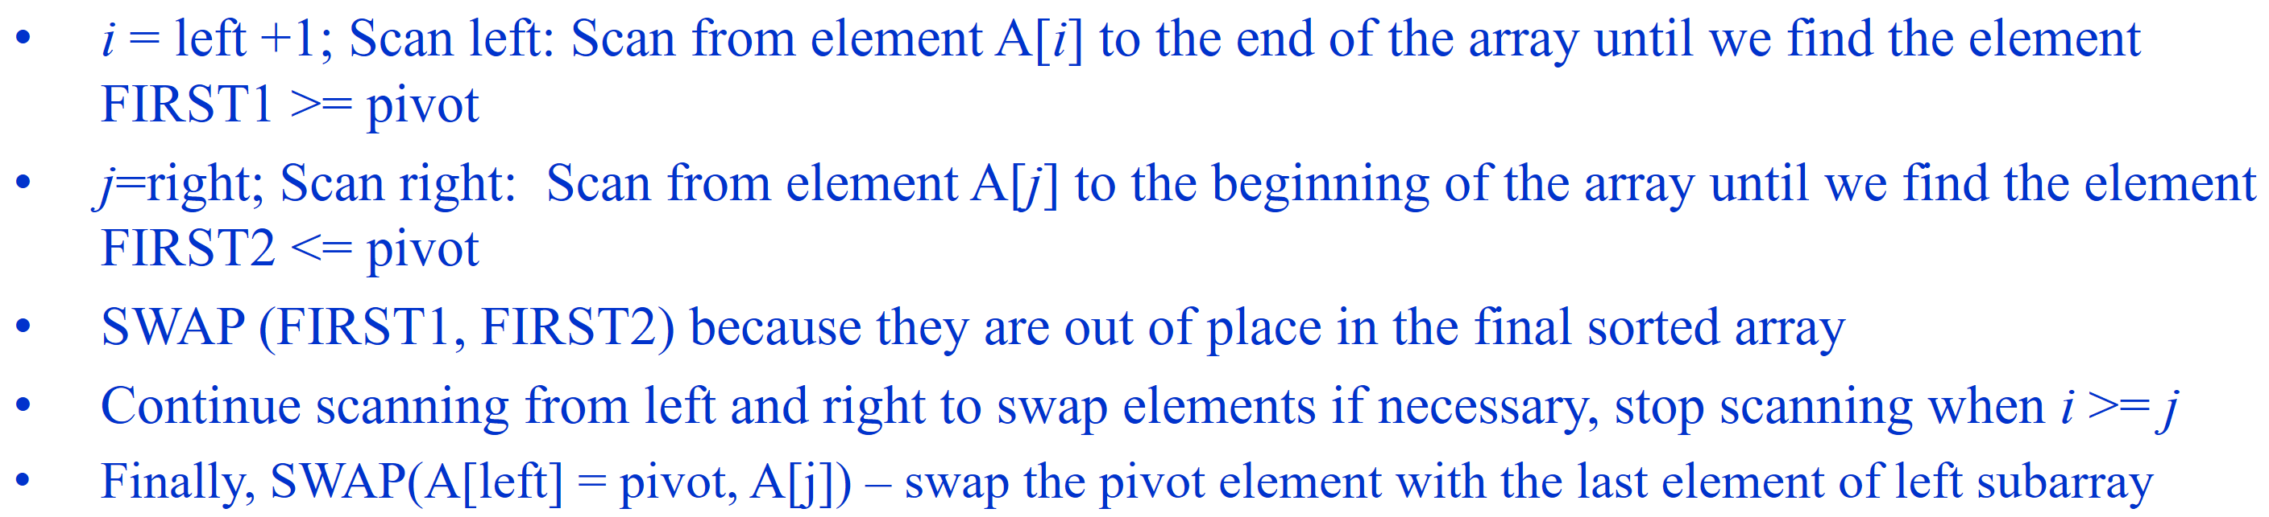
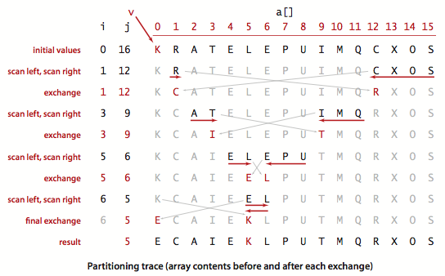
Example: the process of executing the partition function when selecting the last element of the array as the pivot
left
right
pivot
A[ ]

Slide 100
The pivot is the first element of the array
Partition(A, left, right)
i = left; j = right + 1;
pivot = A[left];
while (true) do
{
i = i + 1;
//Scan left: find the first element >= pivot:
while i ≤ right and A[i] < pivot do i = i + 1;
j = j – 1;
//Scan right: find the first element <= pivot:
while j ≥ left and pivot < A[j] do j = j – 1;
if (i >= j) break;
swap(A[i] , A[j]);
}
swap(A[j], A[left]);
return j;
pivot is the first element of the array
j is the index (jpivot) need to be returned, therefore, need to swap position of a[left] and a[j]
After selecting the pivot, move the pointer i and j from the beginning and the end of the array, and swap pair of elements a[i] and a[j] such that a[i] > pivot and a[j] <= pivot
i
j

Slide 101
The pivot is the first element of the array
pivot_index = 0
40
20
10
80
60
50
7
30
100
[0] [1] [2] [3] [4] [5] [6] [7] [8]
i
j

Slide 102
The pivot is the first element of the array
While i <= right and A[i] < pivot
++i
pivot_index = 0
40
20
10
80
60
50
7
30
100
[0] [1] [2] [3] [4] [5] [6] [7] [8]
i
j

Slide 103
The pivot is the first element of the array
While i <= right and A[i] < pivot
++i
pivot_index = 0
40
20
10
80
60
50
7
30
100
[0] [1] [2] [3] [4] [5] [6] [7] [8]
i
j

Slide 104
The pivot is the first element of the array
While i <= right and A[i] < pivot
++i
pivot_index = 0
40
20
10
80
60
50
7
30
100
[0] [1] [2] [3] [4] [5] [6] [7] [8]
i
j

Slide 105
The pivot is the first element of the array
While i <= right and A[i] < pivot
++i
While j >=left and A[j] > pivot
--j
pivot_index = 0
40
20
10
80
60
50
7
30
100
[0] [1] [2] [3] [4] [5] [6] [7] [8]
i
j

Slide 106
The pivot is the first element of the array
While i <= right and A[i] < pivot
++i
While j >=left and A[j] > pivot
--j
pivot_index = 0
40
20
10
80
60
50
7
30
100
[0] [1] [2] [3] [4] [5] [6] [7] [8]
i
j

Slide 107
The pivot is the first element of the array
While i <= right and A[i] < pivot
++i
While j >=left and A[j] > pivot
--j
If i < j
swap(A[i], A[j])
pivot_index = 0
40
20
10
80
60
50
7
30
100
[0] [1] [2] [3] [4] [5] [6] [7] [8]
i
j

Slide 108
The pivot is the first element of the array
While i <= right and A[i] < pivot
++i
While j >=left and A[j] > pivot
--j
If i < j
swap(A[i], A[j])
pivot_index = 0
40
20
10
30
60
50
7
80
100
[0] [1] [2] [3] [4] [5] [6] [7] [8]
i
j

Slide 109
The pivot is the first element of the array
While i <= right and A[i] < pivot
++i
While j >=left and A[j] > pivot
--j
If i < j
swap(A[i], A[j])
While j > i, go to 1.
pivot_index = 0
40
20
10
30
60
50
7
80
100
[0] [1] [2] [3] [4] [5] [6] [7] [8]
i
j

Slide 110
The pivot is the first element of the array
While i <= right and A[i] < pivot
++i
While j >=left and A[j] > pivot
--j
If i < j
swap(A[i], A[j])
While j > i, go to 1.
pivot_index = 0
40
20
10
30
60
50
7
80
100
[0] [1] [2] [3] [4] [5] [6] [7] [8]
i
j

Slide 111
The pivot is the first element of the array
While i <= right and A[i] < pivot
++i
While j >=left and A[j] > pivot
--j
If i < j
swap(A[i], A[j])
While j > i, go to 1.
pivot_index = 0
40
20
10
30
60
50
7
80
100
[0] [1] [2] [3] [4] [5] [6] [7] [8]
i
j

Slide 112
The pivot is the first element of the array
While i <= right and A[i] < pivot
++i
While j >=left and A[j] > pivot
--j
If i < j
swap(A[i], A[j])
While j > i, go to 1.
pivot_index = 0
40
20
10
30
60
50
7
80
100
[0] [1] [2] [3] [4] [5] [6] [7] [8]
i
j

Slide 113
The pivot is the first element of the array
While i <= right and A[i] < pivot
++i
While j >=left and A[j] > pivot
--j
If i < j
swap(A[i], A[j])
While j > i, go to 1.
pivot_index = 0
40
20
10
30
60
50
7
80
100
[0] [1] [2] [3] [4] [5] [6] [7] [8]
i
j

Slide 114
The pivot is the first element of the array
While i <= right and A[i] < pivot
++i
While j >=left and A[j] > pivot
--j
If i < j
swap(A[i], A[j])
While j > i, go to 1.
pivot_index = 0
40
20
10
30
60
50
7
80
100
[0] [1] [2] [3] [4] [5] [6] [7] [8]
i
j

Slide 115
The pivot is the first element of the array
While i <= right and A[i] < pivot
++i
While j >=left and A[j] > pivot
--j
If i < j
swap(A[i], A[j])
While j > i, go to 1.
pivot_index = 0
40
20
10
30
7
50
60
80
100
[0] [1] [2] [3] [4] [5] [6] [7] [8]
i
j

Slide 116
The pivot is the first element of the array
While i <= right and A[i] < pivot
++i
While j >=left and A[j] > pivot
--j
If i < j
swap(A[i], A[j])
While j > i, go to 1.
pivot_index = 0
40
20
10
30
7
50
60
80
100
[0] [1] [2] [3] [4] [5] [6] [7] [8]
i
j

Slide 117
The pivot is the first element of the array
While i <= right and A[i] < pivot
++i
While j >=left and A[j] > pivot
--j
If i < j
swap(A[i], A[j])
While j > i, go to 1.
pivot_index = 0
40
20
10
30
7
50
60
80
100
[0] [1] [2] [3] [4] [5] [6] [7] [8]
i
j

Slide 118
The pivot is the first element of the array
While i <= right and A[i] < pivot
++i
While j >=left and A[j] > pivot
--j
If i < j
swap(A[i], A[j])
While j > i, go to 1.
pivot_index = 0
40
20
10
30
7
50
60
80
100
[0] [1] [2] [3] [4] [5] [6] [7] [8]
i
j

Slide 119
The pivot is the first element of the array
While i <= right and A[i] < pivot
++i
While j >=left and A[j] > pivot
--j
If i < j
swap(A[i], A[j])
While j > i, go to 1.
pivot_index = 0
40
20
10
30
7
50
60
80
100
[0] [1] [2] [3] [4] [5] [6] [7] [8]
i
j

Slide 120
The pivot is the first element of the array
While i <= right and A[i] < pivot
++i
While j >=left and A[j] > pivot
--j
If i < j
swap(A[i], A[j])
While j > i, go to 1.
pivot_index = 0
40
20
10
30
7
50
60
80
100
[0] [1] [2] [3] [4] [5] [6] [7] [8]
i
j

Slide 121
The pivot is the first element of the array
While i <= right and A[i] < pivot
++i
While j >=left and A[j] > pivot
--j
If i < j
swap(A[i], A[j])
While j > i, go to 1.
pivot_index = 0
40
20
10
30
7
50
60
80
100
[0] [1] [2] [3] [4] [5] [6] [7] [8]
i
j

Slide 122
Phần tử chốt là phần tử đứng đầu
While i <= right and A[i] < pivot
++i
While j >=left and A[j] > pivot
--j
If i < j
swap(A[i], A[j])
While j > i, go to 1.
pivot_index = 0
40
20
10
30
7
50
60
80
100
[0] [1] [2] [3] [4] [5] [6] [7] [8]
i
j

Slide 123
The pivot is the first element of the array
While i <= right and A[i] < pivot
++i
While j >=left and A[j] > pivot
--j
If i < j
swap(A[i], A[j])
While j > i, go to 1.
pivot_index = 0
40
20
10
30
7
50
60
80
100
[0] [1] [2] [3] [4] [5] [6] [7] [8]
i
j

Slide 124
The pivot is the first element of the array
While i <= right and A[i] < pivot
++i
While j >=left and A[j] > pivot
--j
If i < j
swap(A[i], A[j])
While j > i, go to 1.
pivot_index = 0
40
20
10
30
7
50
60
80
100
[0] [1] [2] [3] [4] [5] [6] [7] [8]
i
j

Slide 125
The pivot is the first element of the array
While i <= right and A[i] < pivot
++i
While j >=left and A[j] > pivot
--j
If i < j
swap(A[i], A[j])
While j > i, go to 1.
Swap(A[j], A[pivot_index])
7
20
10
30
40
50
60
80
100
pivot_index = 4
[0] [1] [2] [3] [4] [5] [6] [7] [8]
i
j

Slide 126
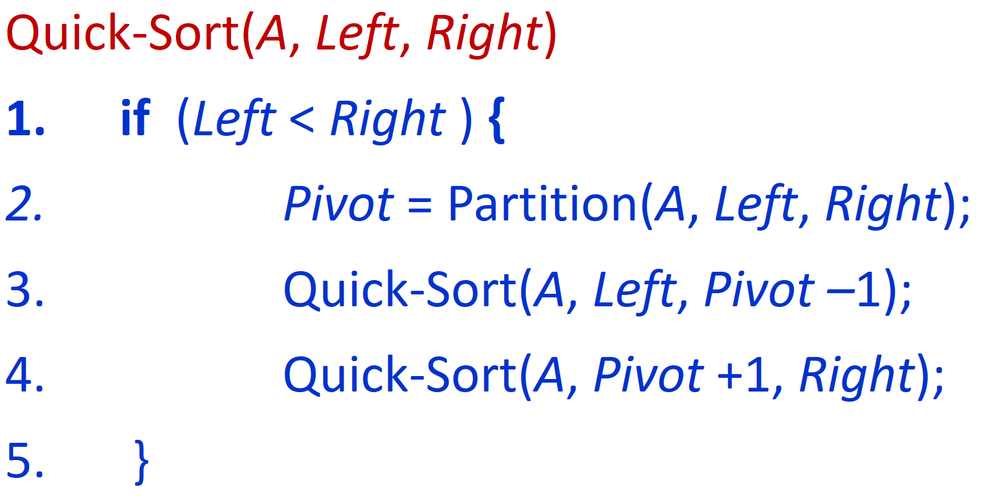
The array obtained after calling: Partition(A,0,8);
7
20
10
30
40
50
60
80
100
[0] [1] [2] [3] [4] [5] [6] [7] [8]
<= A[pivot]
>= A[pivot]
Quick-Sort(A,0,8);
Partition(A,0,8);

Slide 127
Recursion: Quicksort Sub-arrays
7
20
10
30
40
50
60
80
100
[0] [1] [2] [3] [4] [5] [6] [7] [8]
<= A[pivot]
> A[pivot]
Quick-Sort(A,0,8);
4 =
Partition(A,0,8);
Quick-Sort(A, 0, 3);
Quick-Sort(A, 5, 8);

Slide 128
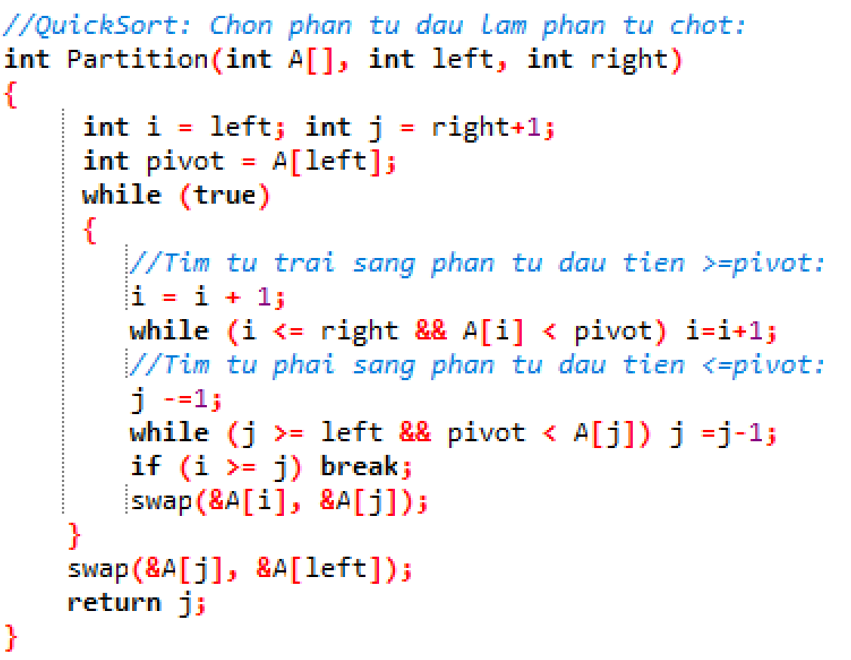
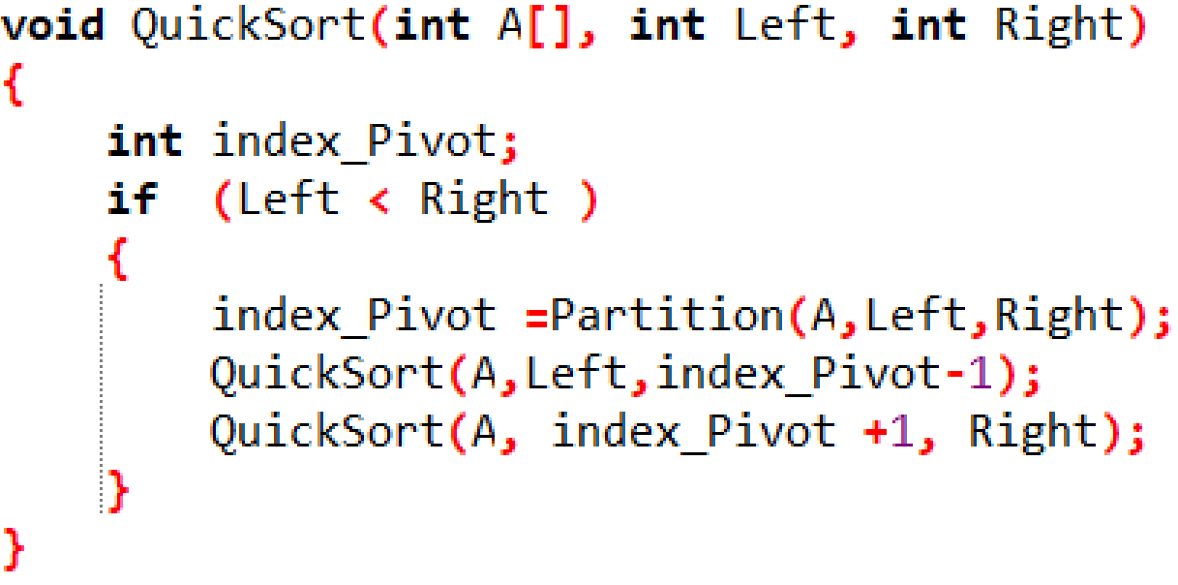
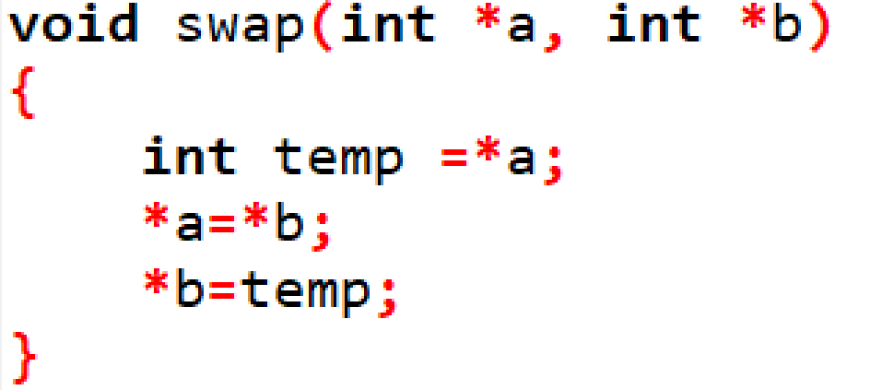
Source code QuickSort: The pivot is the first element of the array
Notes:
//QuickSort: Chon phan tu dau lam phan tu chot:
int Partition(int A[], int left, int right)
{
int i = left; int j = right+1;
int pivot = A[left];
while (true)
{
//Tim tu trai sang phan tu dau tien >pivot:
while (A[++i] < pivot)
if (i==right) break;
//Tim tu phai sang trai phan tu dau tien < pivot
while (pivot < A[--j]);
// if (j==left) break; //khong can thiet vi phan tu chot a[left] acts as sentinel
if (i >= j) break;
swap(&A[i], &A[j]);
}
swap(&A[j], &A[left]);
return j;
}
//QuickSort: Chon phan tu dau lam phan tu chot:
int Partition1(int A[], int left, int right)
{
int i = left; int j = right+1;
int pivot = A[left];
while (i<j)
{
//Tim tu trai sang phan tu dau tien >pivot:
do
i = i + 1;
while (i <= right && A[i] < pivot);
//Tim tu phai sang phan tu dau tien <=pivot:
do
j -=1;
while (j >= left && pivot < A[j]);
//if (i < j)
swap(&A[i], &A[j]);
}
swap(&A[i], &A[j]);
swap(&A[j], &A[left]);
return j;
}
//QuickSort: Chon phan tu dau lam phan tu chot:
int Partition2(int A[], int left, int right)
{
int i = left; int j = right+1;
int pivot = A[left];
while (true)
{
//Tim tu trai sang phan tu dau tien >=pivot:
i = i + 1;
while (i <= right && A[i] < pivot) i=i+1;
//Tim tu phai sang phan tu dau tien <=pivot:
j -=1;
while (j >= left && pivot < A[j]) j =j-1;
if (i >= j) break;
swap(&A[i], &A[j]);
}
swap(&A[j], &A[left]);
return j;
}
void QuickSort2way(int A[], int Left, int Right)
{
int index_Pivot;
if (Left < Right )
{
index_Pivot =Partition2(A,Left,Right);
QuickSort2way(A,Left, index_Pivot-1);
QuickSort2way(A, index_Pivot +1, Right);
}
}

Slide 129

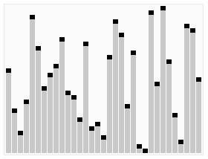
4.5. Quick sort
Developed by British computer scientist Tony Hoare in 1959 and published in 1961,
Quick sort has the average running time O(n log n), however the worst running time is O(n²).
Quick sort is in place, but not stable.
Quick sort is easy in theory but difficult to implement.
C.A.R. Hoare
January 11, 1934
ACM Turing Award, 1980
Photo: 2006

Slide 130
Contents
4.1. Insertion Sort
4.2. Selection Sort
4.3. Bubble Sort
4.4. Merge Sort
4.5. Quick Sort
4.6. Heap Sort
O(n²)
Divide and conquer
O(nlog₂n)

Slide 131
The Heap Data Structure
Definition: A heap is a binary tree with the following two properties:
Structural property: all levels are full, except possibly the last one, which is filled from left to right
Order (heap) property: for any node x
Parent(x) ≥ x : max-heap
OR Parent(x) ≤ x : min-heap
8
From the heap property, it follows that:
“The root is the maximum element of the max-heap!”
7
4
5
2
MAX-Heap
A heap is a binary tree that is filled in order

Slide 132
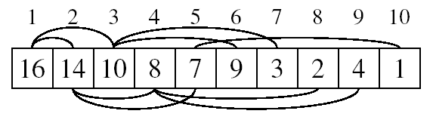
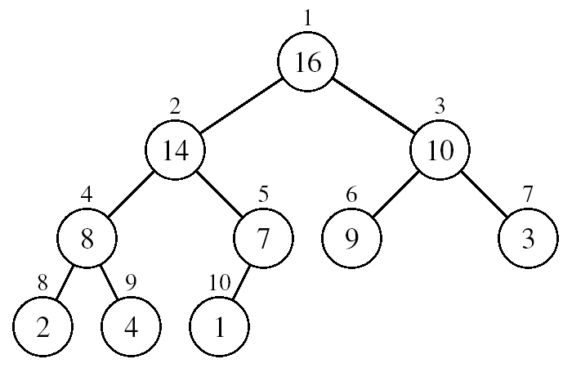
Array Representation of Heaps
A heap can be stored as an array A.
Root of tree is A[1]
Left child of A[i] = A[2*i]
Right child of A[i] = A[2*i + 1]
Parent of A[i] = A[ ⎣i/2⎦ ]
Heapsize[A] ≤ length[A]
The elements in the subarray A[(⎣n/2⎦+1) .. n] are leaves

Slide 133
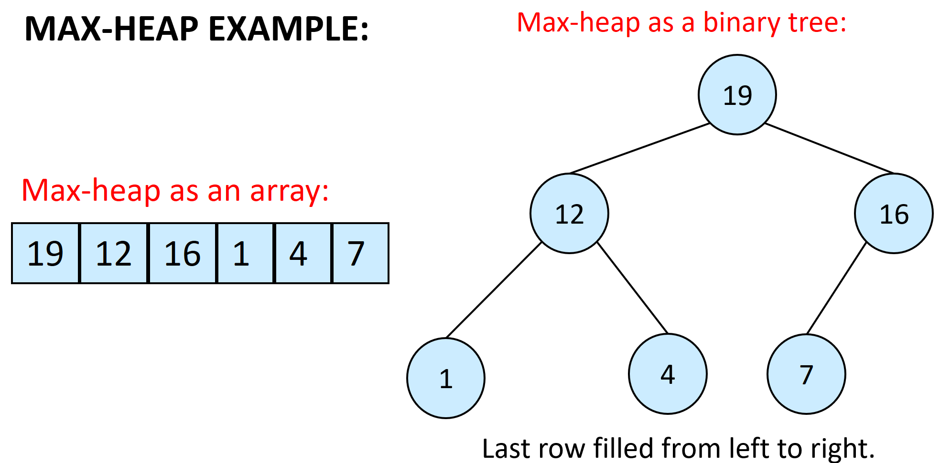
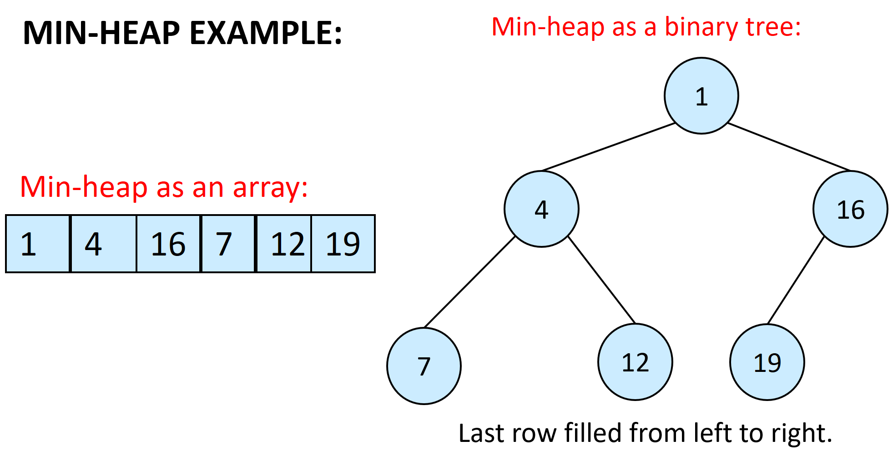
Heap Types
Max Heap
Used to sort array in ascending order
Has property: for all nodes i, excluding the root:
A[PARENT(i)] ≥ A[i]
Min Heap
Used to sort array in descending order
Has property: : for all nodes i, excluding the root:
A[PARENT(i)] ≤ A[i]

Slide 134
Operations on Heaps
Maintain/Restore the max-heap property
MAX-HEAPIFY
Create a max-heap from an unordered array
BUILD-MAX-HEAP
Sort an array in place
HEAPSORT

Slide 135
Operations on Heaps
Maintain/Restore the max-heap property
MAX-HEAPIFY
Create a max-heap from an unordered array
BUILD-MAX-HEAP
Sort an array in place
HEAPSORT

Slide 136

Max-heap: MAX-HEAPIFY
If there exists a node i is smaller than its child (left and right subtree of node i are max-heaps), then it is violated the max-heap property, we need to eliminate it by calling MAX-HEAPIFY
Exchange node i with its larger child
Move down the tree
Continue until node is not smaller than its children
i
4
14
14
Swap 4 and 14
Swap 4 and 8
i
14
7
4
7
8
7
2
8
1
2
8
1
2
4
1
It is not max-heap because:
Max-heap property is violated
It is not max-heap because:
Max-heap property is violated
Max heap

Slide 137
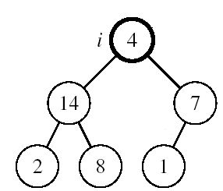
MAX-HEAPIFY: Maintaining the Max-Heap Property
Alg: MAX-HEAPIFY(A, i, n)
l ← LEFT(i)
r ← RIGHT(i)
if l ≤ n and A[l] > A[i]
then largest ←l
else largest ←i
if r ≤ n and A[r] > A[largest]
then largest ←r
if largest ≠ i
then exchange A[i] ↔ A[largest]
MAX-HEAPIFY(A, largest, n)
Assumptions:
Left and Right subtrees of i are max-heaps
A[i] may be smaller than its children

Slide 138
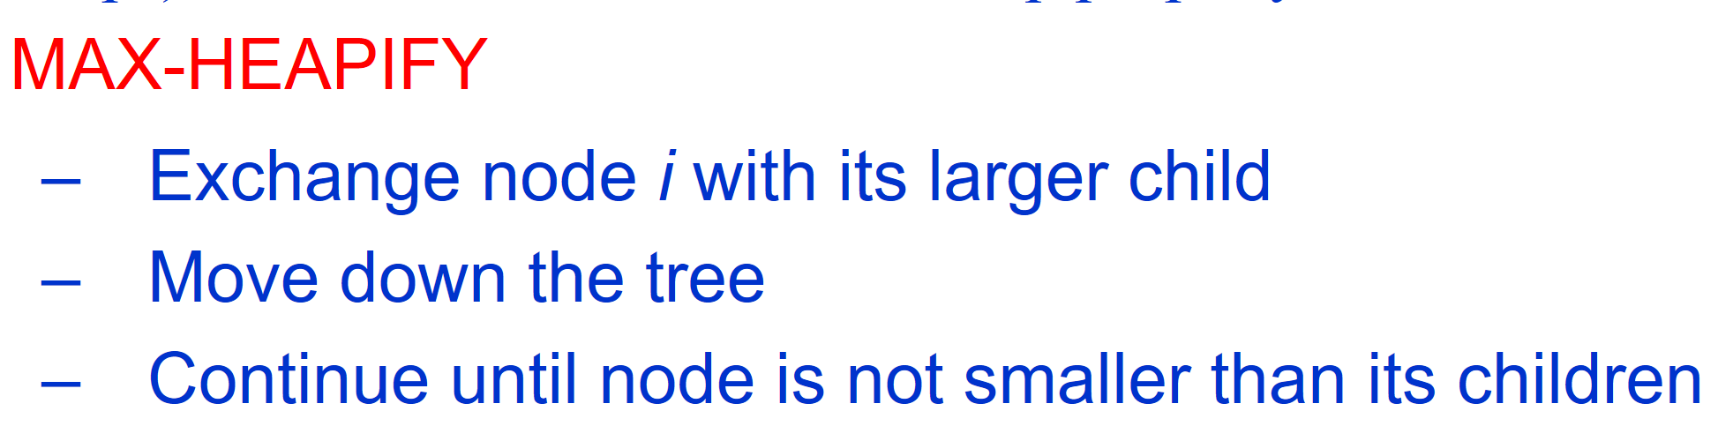
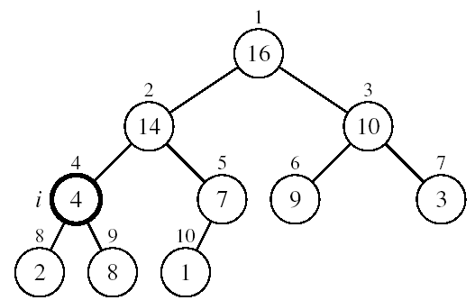
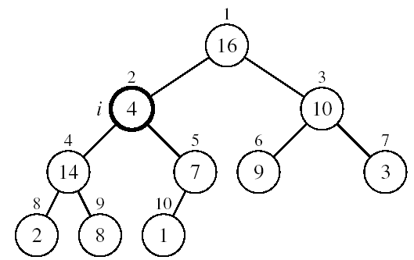
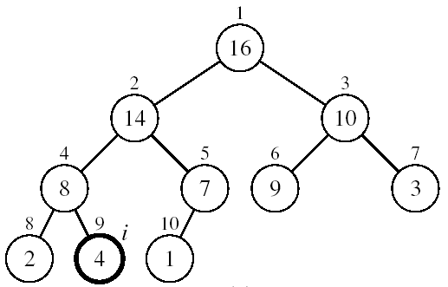
Example
A[2] ↔ A[4]
A[2] violates the max-heap property
A[4] violates the max-heap property
➔CALL: MAX-HEAPIFY(A, 2, 10);
to restore the max-heap property
A[4] ↔ A[9]
MAX-HEAPIFY(A,2,10) is terminated; and we get a Max heap
Heap property restored

Slide 139
Operations on Heaps
Maintain/Restore the max-heap property
MAX-HEAPIFY
Create a max-heap from an unordered array
BUILD-MAX-HEAP
Sort an array in place
HEAPSORT

Slide 140
Create a max-heap from an unordered array: BUILD-MAX-HEAP
We want to convert an array A[1 … n] into a max-heap (n = length[A]) in which the elements in the subarray A[(⎣n/2⎦+1) .. n] are leaves:
Apply MAX-HEAPIFY on elements between 1 and ⎣n/2⎦
Alg: BUILD-MAX-HEAP(A)
n = length[A]
for i ← ⎣n/2⎦ downto 1
do MAX-HEAPIFY(A, i, n)
Apply MAX-HEAPIFY on internal nodes A[⎣n/2⎦] … A[1]
1
4
2
3
1
3
A:
4 | 1 | 3 | 2 | 16 | 9 | 10 | 14 | 8 | 7
4
5
6
7
2
16
9
10
8
9
10
14
8
7

Slide 141
Example: given an array A, build max-heap to represent A
A:
4 | 1 | 3 | 2 | 16 | 9 | 10 | 14 | 8 | 7
Initial:
(not max-heap)
1
4
To make this tree become max-heap: we need to apply MAX-HEAPIFY on all internal nodes: A[⎣n/2⎦] …A[1]
2
3
1
3
4
5
6
7
2
16
9
10
⎣ 10/2 ⎦ = 5
8
9
10
14
8
7
i = 5: CALL MAX-HEAPIFY(A,5,10)
1
4
2
3
A[5] = 16 is greater than all its children (A[10]=7)
➔ ok; don’t need to do anything
1
3
4
5
6
7
2
16
9
10
8
9
10
14
8
7

Slide 142
Example: given an array A, build max-heap to represent A
A:
4 | 1 | 3 | 2 | 16 | 9 | 10 | 14 | 8 | 7
i = 4: CALL MAX-HEAPIFY(A,4,10)
i = 3: CALL MAX-HEAPIFY(A,3,10)
i = 2: CALL MAX-HEAPIFY(A,2,10)
1
1
1
4
4
4
A[4] ↔ A[8]
A[3] ↔ A[7]
2
3
2
3
2
3
1
3
1
3
1
10
4
5
6
7
4
5
6
7
4
5
6
7
2
16
9
10
14
16
9
10
14
16
9
3
8
9
10
8
9
10
8
9
10
14
8
7
2
8
7
2
8
7
i = 1: CALL MAX-HEAPIFY(A,1,10)
1
1
4
4
A[2] ↔ A[5]
2
3
A[5] ↔ A[10]
2
3
16
10
16
10
4
5
6
7
4
5
6
7
14
5
9
3
14
7
9
3
8
9
10
8
9
10
2
8
7
2
8
5

Slide 143
Example: given an array A, build max-heap to represent A
A:
4 | 1 | 3 | 2 | 16 | 9 | 10 | 14 | 8 | 7
i = 1: CALL MAX-HEAPIFY(A,1,10)
1
1
4
16
2
3
A[1] ↔ A[2]
2
3
A[2] ↔ A[4]
16
10
4
10
4
5
6
7
4
5
6
7
14
7
9
3
14
7
9
3
8
9
10
8
9
10
2
8
1
2
8
1
1
1
16
16
2
3
A[4] ↔ A[9]
2
3
Max heap
14
10
14
10
4
5
6
7
4
5
6
7
4
7
9
3
8
7
9
3
8
9
10
8
9
10
2
8
1
2
4
1

Slide 144
Operations on Heaps
Maintain/Restore the max-heap property
MAX-HEAPIFY
Create a max-heap from an unordered array
BUILD-MAX-HEAP
Sort an array in place
HEAPSORT algorithm

Slide 145
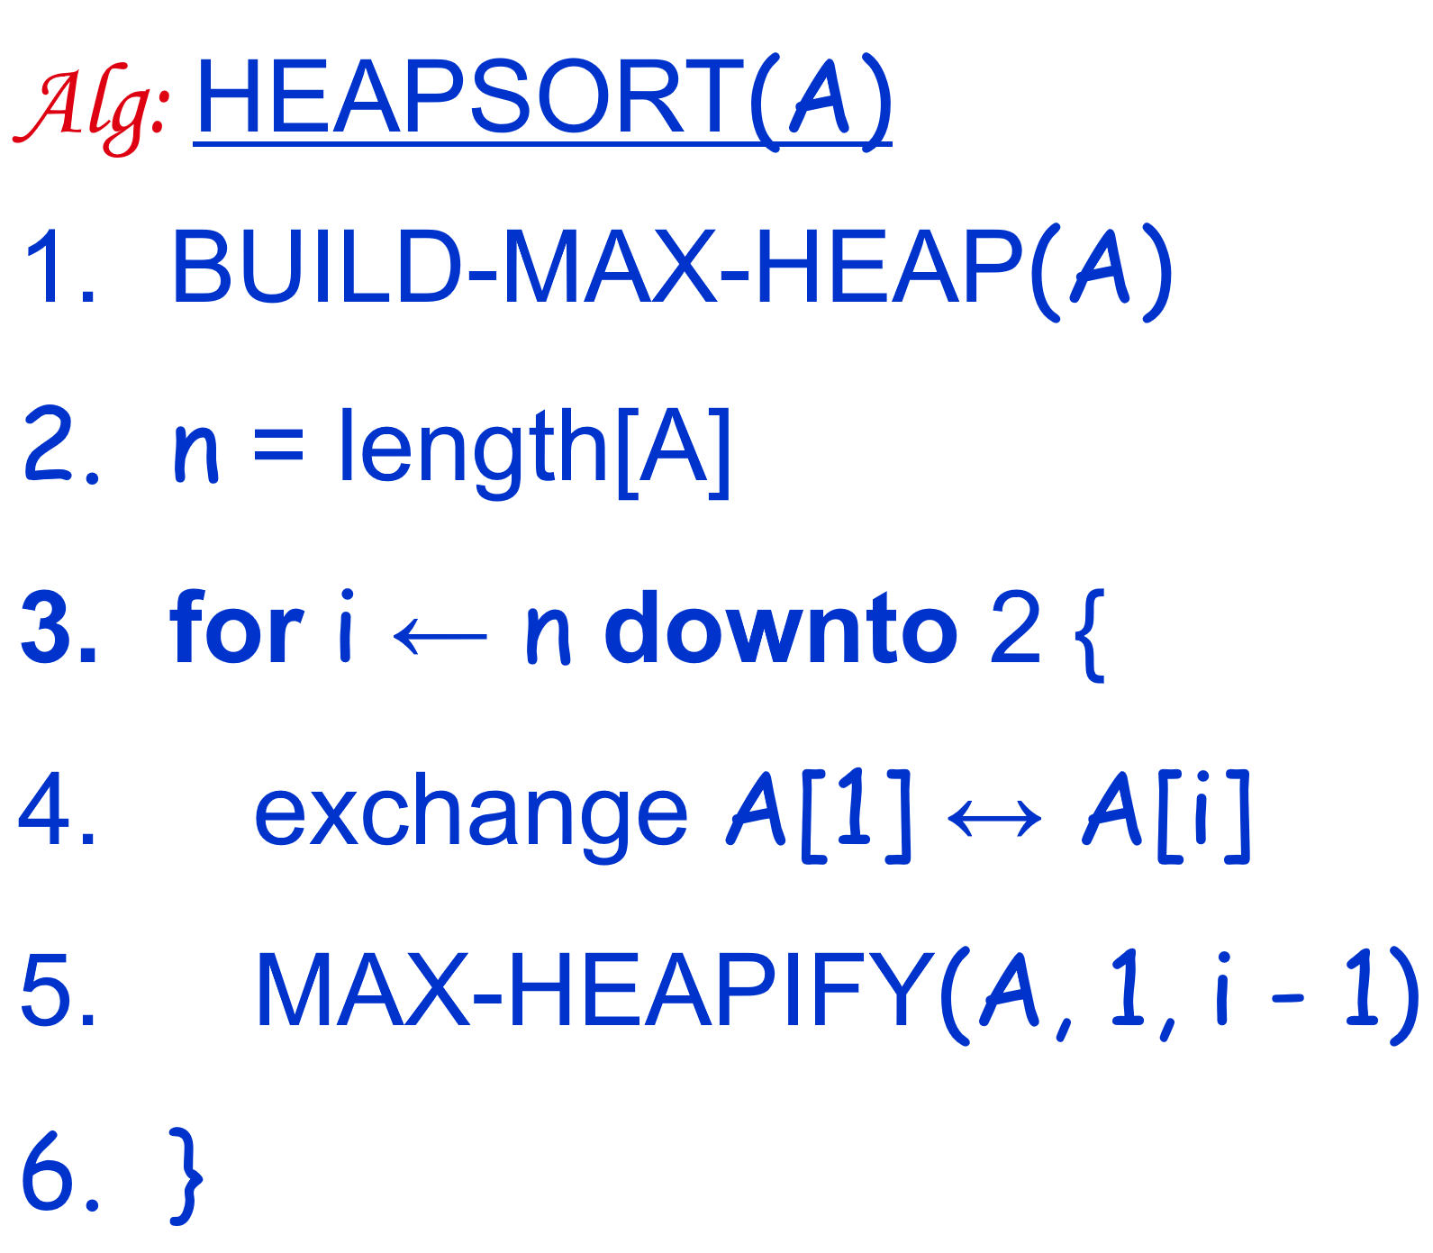
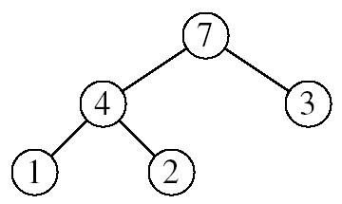
Heapsort algorithm
Goal: Sort an array in ascending order using heap representations
Idea:
Use procedure BUILD-MAX-HEAP to build a max-heap on the input array A[1 . . n].
Since the maximum element of the array is now stored at the root A[1], it can be put into its correct final position by exchanging it with A[n] (the last element in A).
Discard node n from the max-heap by decreasing the max-heap size.
The new element at the root may violate the max-heap property. Thus, we need to call MAX-HEAPIFY on the new root to restore the max-heap property.
Repeat this process (2-3-4) until only one node remains

Slide 146
Alg: HEAPSORT(A)
Alg: HEAPSORT(A)
BUILD-MAX-HEAP(A)
n = length[A]
for i ← n downto 2 {
exchange A[1] ↔ A[i]
MAX-HEAPIFY(A, 1, i - 1)
}
➔ Running time: O(nlog₂n)
O(n)
n-1 times
O(log₂n)

Slide 147
Example 1: Sort array A in ascending order
A:
Step 1: Represent array as a complete binary tree
Step 2: Call HEAPSORT(A):
16
4
7
1
12
19
A[1]
A[2]
A[3]
A[4]
A[5]
A[6]
1
16
2
4
3
7
12
19
6
4
1
5
1. Call BUILD-MAX-HEAP(A): to make this tree become max-heap

Slide 148
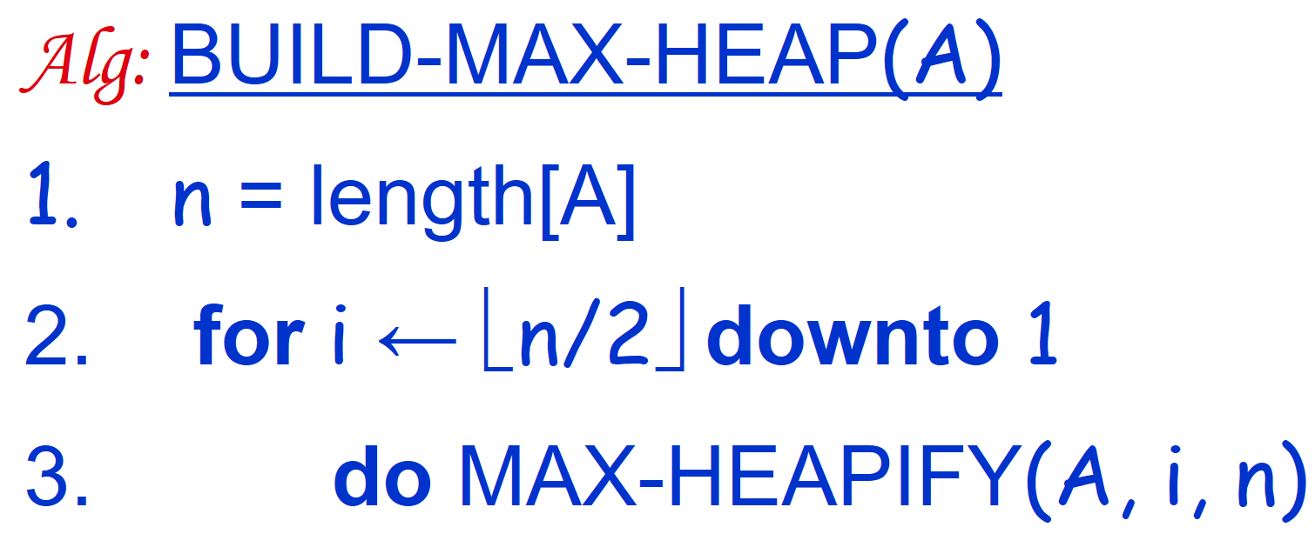
Example 1: Sort array A in ascending order
Step 2: Call HEAPSORT(A):
BUILD-MAX-HEAP(A)
n = 6
1
16
2
To make this tree become max-heap: we need to apply MAX-HEAPIFY on all internal nodes:
A[⎣n/2⎦] …A[1]
4
3
7
⎣ 6/2 ⎦ = 3
12
19
6
4
1
5

Slide 149
BUILD-MAX-HEAP(A): call MAX-HEAPIFY on all internal nodes
i = 3: Call MAX-HEAPIFY(A,3,6)
i = 2: Call MAX-HEAPIFY(A,2,6)
1
16
1
16
2
4
3
7
A[3] ↔ A[6]
2
4
3
19
A[2] ↔ A[5]
1
12
7
4
5
6
1
12
4
5
7
6
i = 1: Call MAX-HEAPIFY(A,1,6)
1
16
1
19
2
12
3
19
A[1] ↔ A[3]
2
12
3
16
Max heap
1
4
7
1
4
7
4
5
6
4
5
6

Slide 150
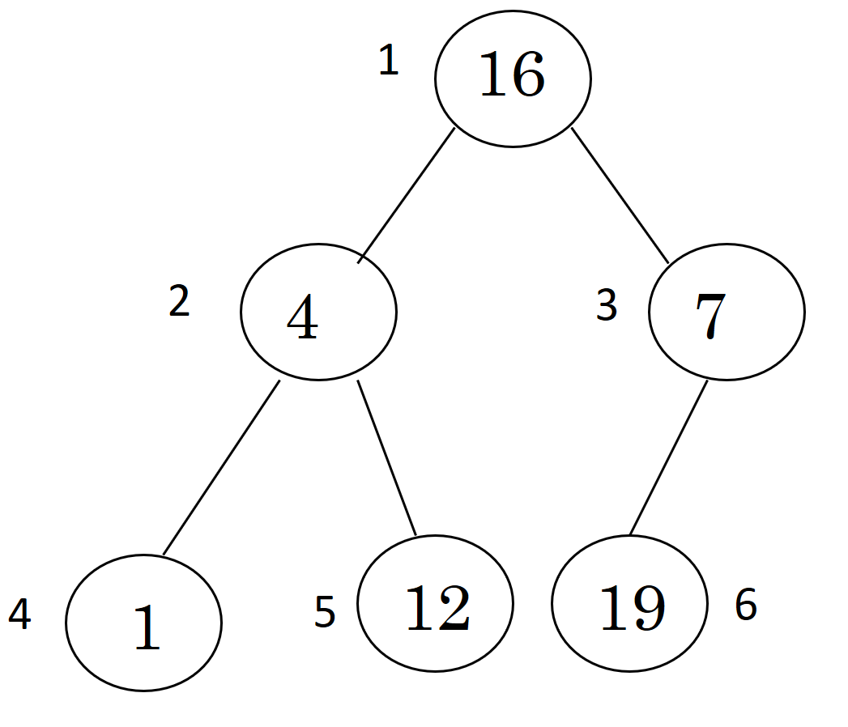
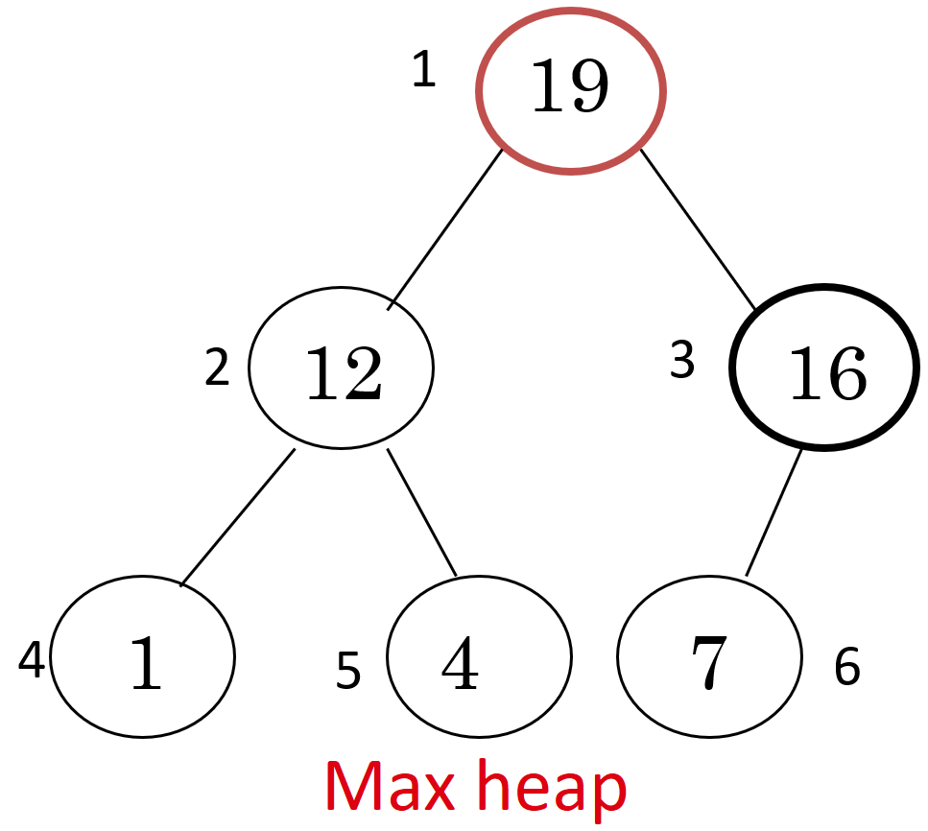
Example 1: Sort array A in ascending order
A:
Step 1: Represent array as a complete binary tree
Step 2: Call HEAPSORT(A):
16
4
7
1
12
19
A[1]
A[2]
A[3]
A[4]
A[5]
A[6]
1. Call BUILD-MAX-HEAP(A): to make this tree become max-heap

Slide 151
Example 1: Sort array A in ascending order
A:
Step 1: Represent array as a complete binary tree
Step 2: Call HEAPSORT(A):
16
4
7
1
12
19
A[1]
A[2]
A[3]
A[4]
A[5]
A[6]
1. Call BUILD-MAX-HEAP(A): to make this tree become max-heap
2. Do lines 3-6

Slide 152
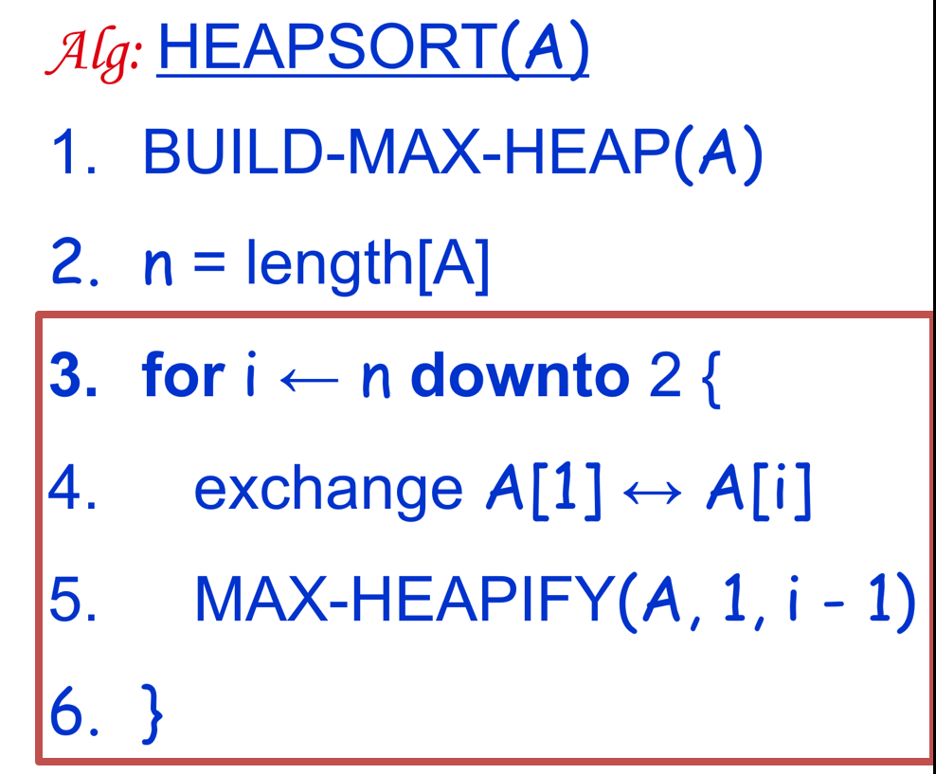
Example 1:
Max-heap:
1
7
i=6:
1
19
A[1] ↔ A[6]
2
12
3
16
2
12
3
16
Exchange last element
and the root
Take out biggest
1
4
7
1
4
19
19
4
5
6
4
5
6
Call MAX-HEAPIFY(A,1,5)
1
7
Array A:
Sorted:
2
12
3
16
7
12
16
1
4
19
1
4
19
4
5
6

Slide 153
Example 1:
Call MAX-HEAPIFY(A,1,5)
1
to restore max-heap property
1
16
7
A[1] ↔ A[3]
i=5:
12
3
2
12
3
16
2
7
A[1] ↔ A[5]
Exchange last element
and the root
1
4
19
1
4
19
4
5
4
5
6
6
Call MAX-HEAPIFY(A,1,4)
1
4
Array A:
Sorted:
12
3
4
12
7
1
16
19
2
7
Take out biggest
16
1
16
19
4
5
6

Slide 154
Example 1:
Call MAX-HEAPIFY(A,1,4)
1
4
to restore max-heap property
1
12
A[1] ↔ A[2]
i=4:
12
3
2
7
4
3
2
7
A[1] ↔ A[4]
Exchange last element
and the root
1
16
19
1
16
19
4
5
4
5
6
6
Call MAX-HEAPIFY(A,1,3)
1
1
Array A:
Sorted:
4
3
12
16
19
2
7
1
4
7
Take out biggest
12
12
16
19
4
5
6

Slide 155
Example 1:
Call MAX-HEAPIFY(A,1,3)
1
1
to restore max-heap property
1
7
A[1] ↔ A[3]
1
i=3:
4
3
2
7
2
4
3
A[1] ↔ A[3]
Exchange last element
and the root
12
16
19
12
4
5
4
5
16
19
6
6
Call MAX-HEAPIFY(A,1,2)
1
1
Array A:
Sorted:
4
3
12
16
19
2
7
1
4
7
Take out biggest
7
12
16
19
4
5
6

Slide 156
Example 1:
Call MAX-HEAPIFY(A,1,2)
1
1
to restore max-heap property
1
4
A[1] ↔ A[2]
7
i=2:
4
3
2
7
2
1
3
A[1] ↔ A[2]
Exchange last element
and the root
12
16
19
12
4
5
4
5
16
19
6
6
1
1
Array A:
Sorted:
4
3
4
7
12
16
19
2
7
1
Take out biggest
4
We get array A sorted in ascending order
12
16
19
4
5
6

Slide 157
Example 2: Use heap sort algorithm
To sort the array A in ascending order
A:
7
4
3
1
2
1 2 3 4 5

Slide 158
Example 3: Use heap sort algorithm
To sort the array A in ascending order
A:
26
24
20
18
17
19
13
12
14
11
1 2 3 4 5 6 7 8 9 10
26
24
20
18
17
19
13
12
14
11

Slide 159
Summary
4.1. Insertion Sort
4.2. Selection Sort
4.3. Bubble Sort
4.4. Merge Sort
4.5. Quick Sort
4.6. Heap Sort
O(n²)
Divide and conquer
O(nlog₂n)
O(nlog₂n)

Slide 160
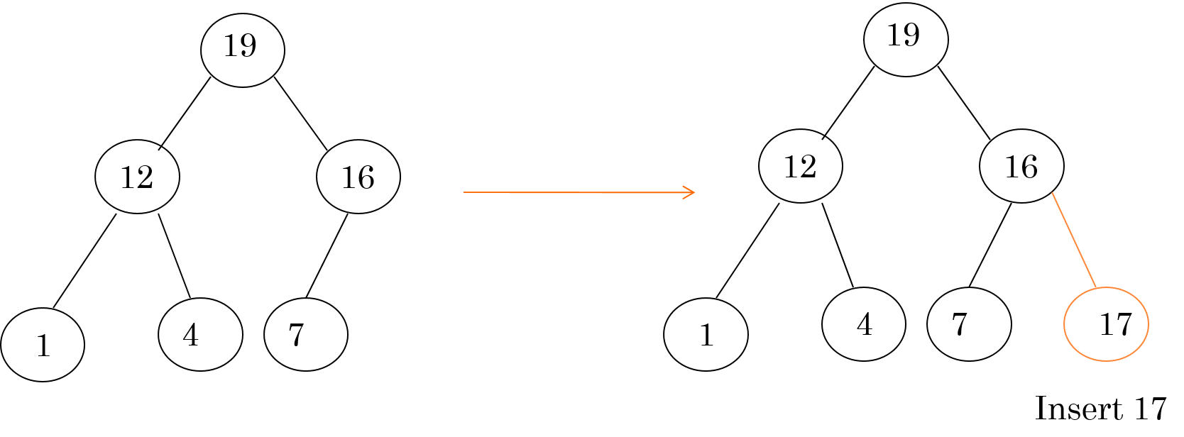
Max-heap: Insertion/Deletion
New nodes are always inserted at the bottom level (left to right)
Nodes are removed from the bottom level (right to left)
After insertion/deletion, need to check whether the max-heap property is violated (that means: there exists the parent of the element is smaller than the element). If there is violation, we need to eliminate it by calling MAX-HEAPIFY

Slide 161
“Bubbling” All the Elements9, 6, 2, 12, 11, 9, 3, 7
a[0]
a[1]
a[2]
a[3]
a[4]
a[5]
a[6]
a[7]
9
6
2
12
11
9
3
7
Original array
6
2
9
11
9
3
7
12
1st iteration
2
6
9
9
3
7
11
12
2nd iteration
2
6
9
3
7
9
11
12
3rd iteration
6 < n - 1
2
6
3
7
9
9
11
12
4th iteration
2
3
6
7
9
9
11
12
5th iteration
2
3
6
7
9
9
11
12
6th iteration
Stop @ iteration 6th because the algorithm identifies that there does not occur any exchange

Slide 162
Sorted
Unsorted
23 | 78 | 45 | 8 | 32 | 56
8 | 78 | 45 | 23 | 32 | 56
8 | 23 | 45 | 78 | 32 | 56
8 | 23 | 32 | 78 | 45 | 56
8 | 23 | 32 | 45 | 78 | 56
8 | 23 | 32 | 45 | 56 | 78
Original array
After iteration 1
After iteration 2
After iteration 3
After iteration 4
After iteration 5

